Slide 1
Problems and Solutions in Assessing Speaking with Young Learners
Too Many Voices:
Martin Goosey, British Council Viet Nam
Notes:
Welcome to the final session! Thanks for staying.
This is a talk for teachers, especially those who struggle with assessing kids’ speaking – it should be useful to anyone from EY to HS, low stakes and high stakes. In fact, there’s no reason that you can’t apply the same principles & techniques to adult classes, but those tend to be smaller – one of the biggest problems with assessing speaking in class is number of people you have to deal with it at once! I.e., the talk does not look at discrete testing exercises, ‘oral exams’ which are organised 1-2-1.

Slide 2
Session Outline
Framed as questions:
Why and how do we assess speaking?
How does the purpose of assessment change if it’s for, of, or as learning?
What difficulties do classroom teachers face in assessing speaking?
What are some solutions? Any examples to share?
Where does learner training fit in?
Any other questions?
Notes:
The session is meant to be interactive: due the nature of the room and audience, this is unfortunately limited to discussions, but as we’re looking at assessing speaking, this is entirely appropriate! After each discussion, we will do a little evaluation.
We will have time for Q&A at the end, so please leave them until then.
For some of the tasks it will help if you imagine you are the class and I am the teacher, as the discussions are designed to be loop-input style.

Slide 3
Speaking #1: Why and how do we assess speaking?
Talk to your partner/s:
Why do we assess speaking?
What does ‘speaking’ involve?
What information do we want to collect when assessing speaking?
What do we do with the information we garner from our assessments?
How does your position as a professional educator influence your intentions as an assessor?
Notes:
2-3 minutes talk. Don’t necessarily discuss all the questions – which look most interesting to you? Start at the top, the middle, or the bottom…

Slide 4
Evaluation #1: Why and how do we assess speaking?
How did you do? Good? Bad? Not finished?
Choose a smiley for your performance. Can you make it physical to show your teacher how you feel?
Source & Licensing: https://commons.wikimedia.org/wiki/File:Emoticons.png
Notes:
Let’s evaluate how ‘successful’ your discussion was. Of course, this is a common technique for instant feedback from learners. You can ask them to use mini-whiteboards, draw, or show you physically (demo).

Slide 5
Evaluation #1: Why and how do we assess speaking?
Of course, asking for learner feedback on tasks is key to evaluation and good practice: it’s a fundamental part of the ‘Visible Learning’ approach outlined by researcher John Hattie:
‘Hattie emphasized that the most powerful feedback is that given from the student to the teacher. This feedback allows teachers to see learning through the eyes of their students. It makes learning visible and facilitates the planning of next steps. The feedback that students receive from their teachers is also vital. It enables students to progress towards challenging learning intentions and goals.’
Source: https://visible-learning.org/glossary/
Notes:
Of course, getting into the habit of asking your students how they think they performed will, in the long run, create a positive mindset towards evaluation, as it simply takes other forms – tests may be more formal, but they still evaluate learning which has already taken place.

Slide 6
Evaluation #1: Why and how do we assess speaking?
Some things I might have heard:
We need to give grades
We need evidence for those
Accuracy, fluency, range, pron, topic
Grammar, vocab, stress, soft skills
Communicative competence
Share results with colleagues, kids, parents, the school… gradebooks!
Use the info in planning, recycling, remedial work…
Testing must be strict! No cheating!
But what of the teacher’s evaluation of learner performance?
Why am I not sure?
How many people do you think I heard just now?
Notes:
So, the question of class size is self-evident. It’s the crux of the matter in assessing speaking, because the evaluation needs to be performed synchronously, unlike reading, listening, and writing. (Recording speaking is possible, but still time-consuming – all it does is shift the time to later for the teacher. Formal testing can use professionals to analyse recordings, but that’s not the topic of this talk.)
Teacher cognition can also be an influencing / influential factor. Are we independent? Do we hold grudges? If the kids were grading each other, would they give different marks? Maybe, but they can’t be trusted, can they? Because they don’t know what they’re doing! So, we have to train them, just like we trained ourselves.

Slide 7
Reflection #1
Why assess? There’s a big difference between formatives and summatives
We use the information in different ways: to inform our teaching, and to inform about learning outcomes
What we look for in assessment can depend on whether it’s high or low stakes, and who the stakeholders are
Oral production is enormously different from Early Years to High School, and contexts vary
It’s not easy to do!
Notes:
These are the key take-aways: there are times when you can’t ask for self- or peer evaluation (e.g., high stakes summatives), but there’s plenty more we can do to help ourselves in class. And we can certainly help our kids by training them in what to do when the high stakes exam finally comes along. That is, in fact, a responsibility for educators.
So, let’s look at different types of classroom assessment purpose.

Slide 8
Speaking #2: Differentiating Assessment Purpose
When I tell you to start, talk to your peers. Define these concepts and agree definitions:
What is Assessment of Learning?
What is Assessment for Learning?
What is Assessment as Learning?
After the discussion, I will ask you if your partner did the assignment well or not. But wait! What about WILF?
‘What I’m Looking For’ is:
Three definitions
Each must be different
You must use the words of, for, as, assessment and learning in your discussion
I want to hear emphatic stress to differentiate the of, for, and as.
You have 120 seconds, so…
no time for phones, you’ll have to talk!
Notes:
WILF is What I’m Looking For… I have to give you success criteria.
At the end of the 120 seconds:
A show of hands – did your partner succeed, more or less?
Hold up a hand to grade your partner: 1 finger is poorly completed, 5 is everything completed well.

Slide 9
Evaluation #2: Differentiating Assessment Purpose
So, what’s the ‘correct’ answer?
What is Assessment of Learning?
Source: https://www.harapnuik.org/?p=8475
Notes:
‘Book definitions’ – but logically, we need to know if our students have learned what we need them to learn, so we have to have some way to ‘test’ if they can do what we’ve prepared them to do.

Slide 10
Evaluation #2: Differentiating Assessment Purpose
What is Assessment for Learning?
Source: https://www.harapnuik.org/?p=8475
Notes:
Another reason to assess we identified earlier was to inform our teaching – to make sure that we go over what’s been misunderstood again.

Slide 11
Evaluation #2: Differentiating Assessment Purpose
What is Assessment as Learning?
Source: https://www.harapnuik.org/?p=8475
Notes:
This is where the students are the assessors. If they know the success criteria, they can identify their own relative success in performance. Did the success criteria I gave you (WILF) help you to do the task efficiently?

Slide 12
Evaluation #2: Differentiating Assessment Purpose
Source: https://www.harapnuik.org/?p=8475
Notes:
Note particularly the who, when, and why.

Slide 13
Reflection #2
We assess for different purposes at different times
We use assessment to report to parents and schools on performance, to inform our teaching, and to train our learners
These are NOT the same things
Learner understanding of our goals means enhanced performance for them, and means improved motivation
Using formative assessment during speaking tasks can help everyone!
Notes:
We hear terms like feedback, evaluation, assessment, examination, test, testing… are they synonyms? In a broad sense they are, so perhaps the more important thing is to think about why we do the activity in the first place. We have words like ‘formative’ and ‘summative’ for that, but sometimes they don’t seem to be enough to help us differentiate what we hope to achieve, so AoL, AfL, & AaL can help clarify in our minds what we want to get out of the exercise – and there can be an overlap!

Slide 14
Speaking #3: What difficulties do teachers face in assessing speaking?
When I tell you to start, discuss in groups of three:
Two people will talk
A third person will monitor their partners
No group? Listen and observe the process. Who spoke best? Why?
If you are the monitor, you need a pen and paper. Write the names of the speakers at the top. Then…
WILF… Consideration of these factors:
Timing and/or class size
Timetable fit
Grading
Prior knowledge of learners
Task instructions
Anything else? Original ideas?
Monitors, tick the name of the person who mentions these factors, or write their idea.
Notes:
Of course, these success criteria are content-based (‘Did you talk about…?’) But they could equally be based in anything you want to measure: grammatical structures, lexis, features of pronunciation… The key thing is that you should have taught the criteria at some point, so the kids see the connection between what they’ve studied and the evaluation: their learning becomes visible to them, so is their progress, and so are the gaps in their capabilities, because they know what you covered in class, and what they didn’t do during the assessment.

Slide 15
Evaluation #3: What difficulties do teachers face in assessing speaking?
Now the monitor can tell their partners what they heard:
Timing ✓
Class size ✓
Timetable fit ✓
Grading ✓
Prior knowledge of learners ✓
Task instructions ✓
Anything else? Say what you heard…
Notes:
So this is peer-to-peer feedback. The teacher has trouble evaluating everyone, and therefore will also struggle to provide useful feedback to every individual. We know feedback is essential to efficient teaching-learning practice (Hattie says!) but the with no feedback to give the learners after the speaking task, we undermine the purpose of some of it. Peer feedback may not always be 100% effective (why is another topic), but it’s better than nothing! And it will be improved with practice and learner training.

Slide 16
Evaluation #3: What difficulties do teachers face in assessing speaking?
Here are some ideas from the teacher:
It’s hard to give accurate grades with so many things to assess
How do we find time for testing in a busy syllabus? Listening to a large class can take several weeks if done 1-2-1!
Can I be sure that I’m being fair to everyone? What if they did their best speaking while I was listening to someone else?
It’s hard to differentiate testing for mixed ability classes
Giving instructions so that everyone knows what to do isn’t easy. Are the instructions part of the test?
Bought tests don’t always reflect what we’ve done in class
How do you prepare the students?
I simply can’t listen to everyone!
Now, if you repeated the exercise, how would you do the second time? Which would be a more accurate reflection of your ability as a speaker?
Notes:
Shouldn’t tests be a surprise? ‘If they don’t know they are going to be tested, don’t you get a better idea of their ‘true’ ability?’ versus ‘What can you learn from a ‘pop quiz’ about real performance ability?’

Slide 17
Reflection #3
If assessment is to support learners, it shouldn’t (typically) be a surprise: what do you really learn from a ‘pop quiz’?
You won’t get a real understanding of a kid’s true ability without supporting them: do you want to know their best or their worst performance?
Kids are generally honest about what their peers do, & can anyway be re-partnered
In any case, you provide the measures and they record them, and you still monitor.
Notes:
It’s debatable whether a stressful situation (speaking at your worst) or relaxed (speaking at your best) is a more ‘realistic’ measure, but we should go back to ask WHY we are doing the exercise. Unless it’s somehow random assessment for learning (What can the learners do easily despite pressure? Because I need to re-teach what they struggle with…) then we ought to support them to do their best, build confidence through positive reinforcement.

Slide 18
Speaking #4a: Possible Solutions
On the next slide, you will see the assessment criteria and test prep document for two grades of the Trinity GESE.
Tell your partner how you could use peer assessment techniques to prepare your learners for this more formal test.
WILF: use the sentence stems on the right to comment on your partner’s performance.
You have two minutes.
[Student Name] …
Used [grammatical structure] to talk about [function].
Said these words from our last lesson:
[______________]
[______________]
Clearly made these sounds that we practised in class:
[___]
[___]
Was [adjective] to understand.
Notes:
GESE = Trinity College London Graded Examinations in Spoken English
Examples:
Used [could] to talk about [possibility].
Said [success criteria] and [assessment of learning].
Was [easy] to understand.

Slide 19
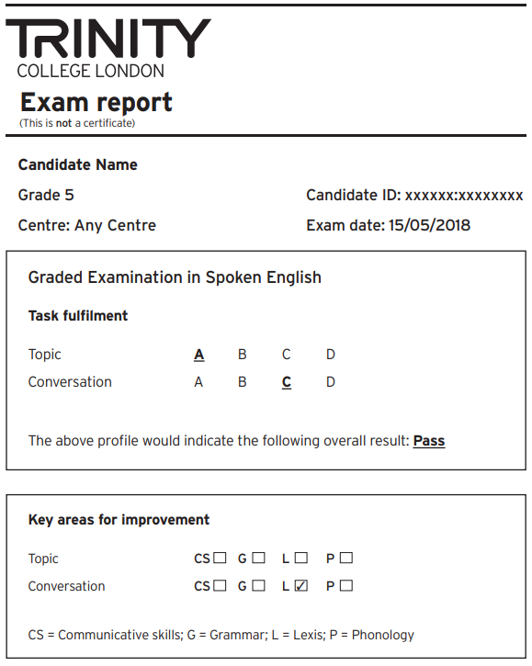
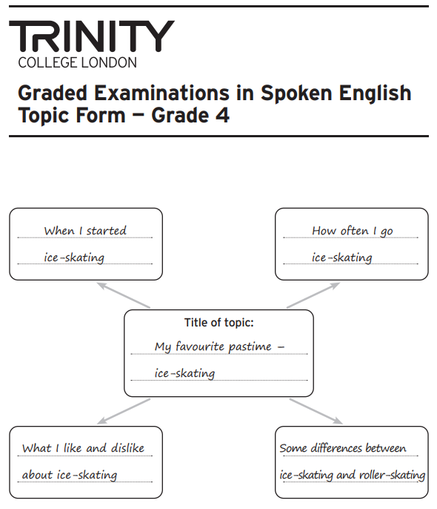
Speaking #4: Possible Solutions
Source: https://www.trinitycollege.com/resource/?id=5755
Notes:
Trinity GESE Grades 4-6 are Elementary, (CEFR level A2.2–B1.2)
The title of the topic Is chosen by the learner, and they get to talk about something they know and like, so they are supported to do their best – that’s fundamental to Trinity’s philosophy.
Could you use the exam report form with your learners, after training?

Slide 20
Speaking #4b: Possible Solutions
On the next slide, you will see the public band descriptors for the IELTS speaking component.
Tell your partner how you could use peer assessment techniques to prepare your learners for this high stakes test.
WILF: use the prompts on the right to comment on your partner’s performance.
You have two minutes.
[Student Name] …
One thing my partner did well in use of grammar: ________________________.
Words the teacher used that my partner did too: ___________________.
Something the teacher taught us, but I didn’t hear: _______________________.
How easy I think my partner was to understand: ______________________.
Something my partner could’ve done to make things easier for me: _____________________________.
Notes:
Same task for IELTS, different format of peer evaluation.

Slide 21
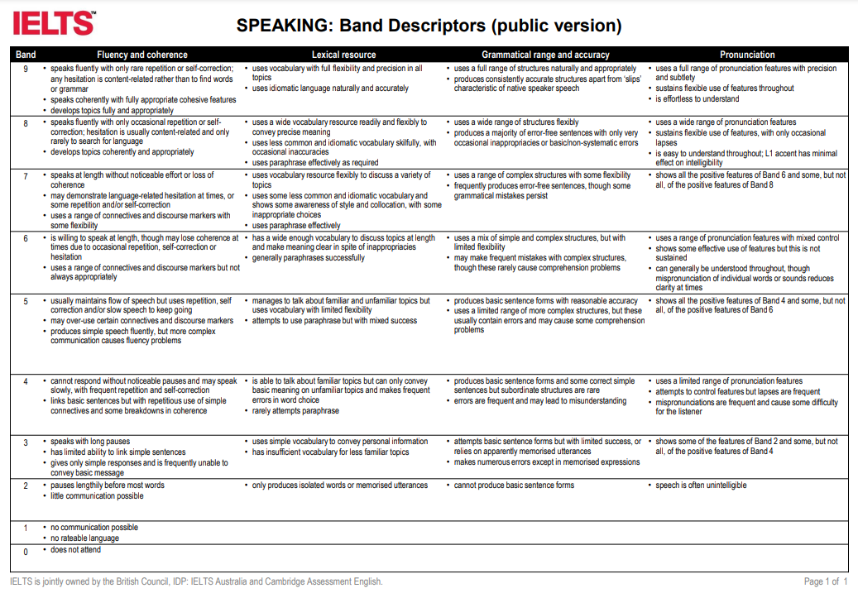
Speaking #4: Possible Solutions
Source: https://www.ielts.org/-/media/pdfs/speaking-band-descriptors.ashx
Notes:
If you can’t read the detail, notice the top 4 criteria.

Slide 22
Evaluation #4: Possible Solutions
You can give the feedback to your peer now. Ask them if they think it was fair and accurate…
If it isn’t, that doesn’t mean the idea doesn’t work – the more often you do it, the better you get.
For instance, for the IELTS Speaking test, you are dealing with broad criteria that you will have previously broken down and practised in class – more detail is good!
Do you need a record, though? This is practice for IELTS, not IELTS itself…
Notes:
What could be better prep for understanding what examiners look for than pretending to be one? But of course, examiners go through a lot of training in how to assess, and so do teachers, so why wouldn’t students who need to know how grading happens? Some time needs to be invested! But this can be done over a whole course, semester, or years…

Slide 23
Evaluation #4: Possible Solutions
Look again at the public descriptors for IELTS Band 6 Speaking.
What detail could you add so your students know what is expected of them?
Source: https://www.ielts.org/-/media/pdfs/speaking-band-descriptors.ashx
Notes:
Fluency & Coherence… Lexical Resource… Grammatical Range & Accuracy… & Pronunciation
Not much time to brainstorm detail: discussion or quick shout out, depending on time. Think just about ‘uses a range of pron features with mixed control’ if really short of time: consider contractions, connected speech, individual sounds, word and sentence stress, and so on.

Slide 24
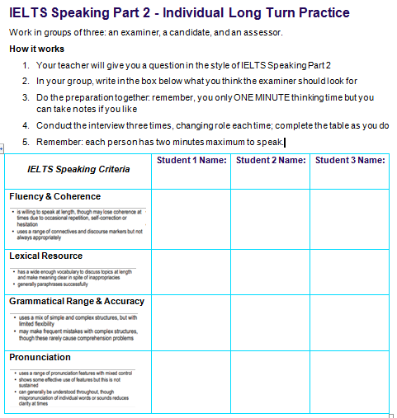
Evaluation #4: Possible Solutions
Look at this evaluation sheet for HS students planning to take IELTS and aiming for a Band 6.
Do you think they could complete it themselves?
Imagine using it with this question:
Source: https://ielts.idp.com/vietnam/prepare/article-free-speaking-practice-questions/en-gb
Notes:
One I made to use with my own class – though not for this particular Part 2 question. They can do it more than once with different partners.
SS can either use the space to write what they think examiners look for, or note what their partners said during the exercise, and then discuss in groups if they think it was appropriate to what they understand examiners look for.

Slide 25
Reflection #4
Repetition is valuable and real – we all do it in daily life - & practice makes perfect!
Learning to learn also means learning how to succeed in tests, to give the assessors what they want – but someone has to show you what that is
Peer assessment works, but you have to introduce the concept piecemeal
Go from telling them what you’re looking for (WILF), to eliciting from them, to asking them to make their own criteria.
Notes:
To end: we go from telling SS what we are looking for, to part-telling and prompts, stem sentences, etc., to eliciting from them completely. A well-trained learner will have done this so many times in class that they are able to tell what the teacher or examiner is looking for, because ultimately there is only so much we DO look for – grammar, pron, lexis, skills, etc. It’s not infinite, and they ought to hear that too, because it’s reassuring!

Slide 26
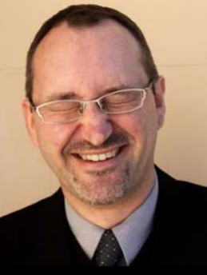
Summary and Q&A
Framed as questions:
What have you considered today that you have haven’t considered before?
Can you name a new word or concept that you haven’t heard before?
When you see your boss, what will you tell them that you got out of this session, to justify your attendance?!
What is one thing you would like to try in your own professional practice?
Make a physical smiley!
Thanks for your participation!
Questions to:
martin.goosey1@britishcouncil.org
Notes:
Questions can be sent if shy or no time.

Slide 27
References
Some used today or that may be useful:
https://www.britishcouncil.vn/en/exam
https://www.trinitycollege.com/qualifications/english-language/GESE
https://www.trinitycollege.com/resource/?id=5755
https://www.ielts.org/
https://ielts.idp.com/vietnam
https://visible-learning.org/glossary/
https://www.teachingenglish.org.uk/

