Slide 1
Empowering teachers to innovate assessment
A collaborative research project and beyond

Slide 2
Presenters
Dr. Nguyen Thi Ngoc Quynh
Dr. Nguyen Thi Chi
Ms. Nguyen Thi Phuong Thao
University of Languages and International Studies (ULIS),
Vietnam National University, Hanoi

Slide 3
Acknowledgement
We gratefully acknowledge the support of the British Council through the UK-Viet Nam Research Grants.
The views expressed in this presentation are those of the presenters and do not represent those of the British Council.

Slide 4
Contents
The collaborative research project
Situation of teacher assessment literacy and practices
Resources for teachers’ professional development

Slide 5
The project
A project to investigate the provision of English language assessment and testing (including online and automated provision) to ensure fairness and inclusivity.
A joint project between the University of Huddersfield and VNU University of Languages and International Studies.

Slide 6
Our approach
Following Berry, Sheehan and Munro (2017, p. 203), the study adopted: “… a social constructivist model of learning and meaning-making, with the language classroom representing the community of practice. It focuses on the sociocultural context in relation to actual assessment literacy practices in the language classroom, since an investigation into what is happening in classes may be of little value without exploring why it is happening.”

Slide 7
Our approach
Language Assessment Literacy Model for the Teaching Profession (LAL-TEP) model (Villa Larenas, 2021)
The components of LAL – beliefs, knowledge, practices, learning and context
LAL “… is socially constructed (and re-constructed) from and for the specific context in which stakeholders’ practices are immersed.” (Villa Larenas and Brunfaut, 2022:27)

Slide 8
LAL-TEP model

Slide 9
Data collection methods
Survey questionnaire
Classroom observations and follow-up interviews
Focus Group Discussions
Stakeholder Interviews

Slide 10
Overview of Survey Questionnaire Participants
2569 responses, 2045 completed responses
from 59/64 provinces in Vietnam, with majority from the north of Vietnam
From varied experiences, ranging from 1 to more than 25 years of teaching in both state and private institutions
With varied qualifications (teaching certificate, bachelor, master, PhD)

Slide 11
Survey of the situation - Teachers’ past experiences as language learners
 | Strongly Agree & Agree (%) | Neutral (%) | Disagree & Strongly Disagree (%)
Some of my language teachers used a variety of assessment techniques. | 50 | 25 | 25
I experienced self-assessment and similar techniques as a student. | 45 | 21 | 33
I worked hard for tests. | 81 | 12 | 7
I disliked being assessed at school. | 20 | 30 | 50
My language teachers used tests created by external assessment authorities. | 27 | 35 | 38
My language teachers shared marking criteria with my class at school. | 55 | 21 | 24
I was afraid of tests at school. | 21 | 31 | 48
My language teachers used assessments to frighten us to work more. | 39 | 30 | 31
Tests were a popular assessment technique experienced by the participants.
Tests and other assessments were used as a way of self-motivation/motivation of learning.
Most participants did not seem to have negative attitudes towards assessments as a language learner.
Testing and assessment seemed to be in-house and teacher-centered.

Slide 12
Survey of the situation – Training experiences
 | Strongly Agree & Agree (%) | Neutral (%) | Disagree & Strongly Disagree (%)
I studied assessment as part of my initial teacher education programme. | 67 | 17 | 16
My assessment practice was assessed during my initial teacher education programme. | 60 | 24 | 16
I learnt how to create assessments during my initial teacher education programme. | 61 | 23 | 16
I learnt how to write tests during my initial teacher education programme. | 58 | 23 | 19
I enjoyed learning about assessment. | 67 | 25 | 8
Initial teacher education programme should focus on teaching. | 60 | 25 | 15
I have been attending training courses in assessment. | 74 | 15 | 11
A considerable proportion of the participants did not receive training on assessment as part of their initial teacher education programme and further professional development trainings.
Most of the participants had positive attitudes towards learning about assessment.
These findings provide partial support to previous findings by Hasselgreen et al. (2004) and Vogt and Tsagari’s (2014) who found that the teachers who carried out most activities related to language testing and assessment without any formal training.

Slide 13
Survey of the situation – Training experiences
I studied assessment as part of my initial teacher education programme.
I have been attending training courses in assessment.
Years of teaching experience | Strongly Agree & Agree (%) | Neutral (%) | Disagree & Strongly Disagree (%)
0-4 years | 66.67 | 21.40 | 11.93
5-9 years | 69.07 | 21.99 | 8.93
10-14 years | 67.57 | 17.72 | 14.71
15-19 years | 62.74 | 21.66 | 15.61
20-24 years | 63.10 | 17.75 | 19.15
25+ years | 52.24 | 17.91 | 29.85
Years of teaching experience | Strongly Agree & Agree (%) | Neutral (%) | Disagree & Strongly Disagree (%)
0-4 years | 51.44 | 26.75 | 21.81
5-9 years | 60.62 | 24.66 | 14.73
10-14 years | 70.15 | 18.51 | 11.34
15-19 years | 67.83 | 21.02 | 11.15
20-24 years | 71.39 | 16.43 | 12.18
25+ years | 70.15 | 11.94 | 17.91
Further findings showing that the percentages of the teacher participants who received training on assessment (either as formal part of their initial teacher education programme or in further in-service training) were not high.

Slide 14
Survey of the situation – Training experiences
I studied assessment as part of my initial teacher education programme.
I have been attending training courses in assessment.
Level of education | Strongly Agree & Agree (%) | Neutral (%) | Disagree & Strongly Disagree (%)
English language centre | 60.53 | 21.05 | 18.42
Vocational training | 100 | 0 | 0
Primary | 67.54 | 20.55 | 11.91
Secondary | 66.67 | 20.55 | 12.79
High school | 61.08 | 18.56 | 20.36
College | 57.14 | 7.14 | 35.71
University | 63.83 | 14.89 | 21.28
Others | 57.58 | 27.27 | 15.15
Level of education | Strongly Agree & Agree (%) | Neutral (%) | Disagree & Strongly Disagree (%)
English language centre | 50.65 | 27.27 | 22.08
Vocational training | 50.00 | 0 | 50.00
Primary | 64.01 | 22.80 | 13.19
Secondary | 70.39 | 18.00 | 11.62
High school | 66.27 | 19.58 | 14.16
College | 50.00 | 21.43 | 28.57
University | 64.89 | 19.15 | 15.96
Others | 60.61 | 15.15 | 24.24
Further findings showing that more teachers need in-service training on assessment, especially teachers of adult learners (at high schools, colleges and universities) and those teaching at language centers and vocational training programmes.

Slide 15
Classroom observations and follow-up interviews
OT7: The teacher delivered the lesson in a lecture-like style, without engaging classroom assessment
“I think the purpose of the lesson in the video is to inform students how an essay should be structured and what criteria should be considered when rating or writing the essay, so I think the purpose was purely informational, so just give students some ideas, so I think that nature [lecture-like] determines my decision was very, how to say, easy-going and the students didn’t take it seriously and I myself didn’t take it seriously either, and no score-related matter was discussed. So I think it made the lesson less stressful for them.” (OT7)
→ Teachers’ misperception of assessment

Slide 16
Focus-group discussions
Usually at the beginning of a lesson, I have a part to check new words and review the grammar of the previous session. This book does not have that part, so I add it. (FGD2)
Teachers’ insufficient knowledge of assessment
(separating assessment from teaching, not using assessment for learning…)

Slide 17
Focus group discussions
FGD question: “What assessment tasks/activities do you conduct with your students?”
With your question about testing activities, at my school, the feature is that English is highly valued, we have enough equipment, my school often has tests to evaluate all 4 skills. Students are equipped with their own laptops, so the English test is also done through its own software, that is, there will be a separate exam software for students that you can use. (FG2)
Teachers’ insufficient knowledge of assessment
(limiting assessment to summative testing only…)

Slide 18
Classroom observation
In a primary class:
Activity 1: T asked Ss to stand up -> Ss stood up -> T: ‘Good!’
Activity 2: T said ‘Good morning’ -> Ss said ‘Good morning’ ->T: ‘Very good’
Activity 3: T sang along with Ss -> T: ‘Very good’
Activity 4: Miming game (stage 1: T mimed the word, Ss said aloud) -> T: ‘Very good’ (3 times), ‘well-done, amazing, good job + “thumb-up” gesture (Used all 4 complimentary words at a time to encourage Ss)
→ Effective feedback?

Slide 19
The situation of Vietnamese teachers’ Language Assessment Literacy and Practices
Many teachers, especially those of adult learners and at language centers and vocational programmes, need more training on assessment.
Many teachers are keen to developing their language assessment practices.
Tests are most commonly used for assessment.
The most common assessments are summative.

Slide 20
What are teachers’ needs and wants?
More regular training to develop professionally
Resources to support their practices properly
A community of practice to share and learn from professional ideas and practices
→ Let’s watch a video to see what is brought to you!

Slide 21
Video
https://youtu.be/iwJ4gTS3kk4

Slide 22
What’s next?
Two scenarios to be analyzed
Immediate discussion to be facilitated via the Community of Practice (COP)
Highlights of the toolkits to be introduced

Slide 23
Scenario 1
Let’s watch and think:
What assessment activities are there in the video?
Are these assessment activities well-organized? How meaningful are they to the learners?
If you were the teacher in this video, what would you like to change?
Source: https://www.youtube.com/watch?v=Cy7lBAlp6u4

Slide 24
Scenario 1
Immediate feedback
Immediate feedback vs. Delayed feedback
Pros and cons?
When to use?
How to use?
You can find the answers in Toolkit 1 – giving feedback
Source: https://www.youtube.com/watch?v=Cy7lBAlp6u4

Slide 25
Scenario 1
Formative assessment
More teaching & less assessment
Reasonable?
Pros and cons?
Unplanned assessment vs. Planned assessment
Pros and cons
Naturally integrated in the lesson?
Suit learners’ age and ability?
You can learn about criteria to evaluate the effectiveness of formative assessment in Toolkit 3 – formative assessment
Source: https://www.youtube.com/watch?v=Cy7lBAlp6u4

Slide 26
Food for thought
“He who loves practice without theory is like the sailor who boards ship without a rudder and compass and never knows where he may cast.”
Leonardo da Vinci
Notes:
Highlighted points:
Teachers need to be aware of the integration between teaching and assessment.
Teachers need to plan assessment activities (as they often do with their teaching activities) so that the assessment can be more effective.
Only by understanding thoroughly the theory can teachers self-judge/adjust their assessment practices in the dynamic classroom situations.

Slide 27
Scenario 2
Let’s watch and think:
How would you assess this speaking performance if you were the examiner?
Do you use any criteria to assess this performance?
Source: https://www.youtube.com/watch?v=nIp8FVs8-f0

Slide 28
Scenario 2
Two types of rating scales:
Holistic scales
Analytic scales
Criteria to assess speaking performance:
Fluency
Pronunciation
Grammar
Vocabulary
Interactiveness
You can find more information in Toolkit 2 – Assessing speaking
Source: https://www.youtube.com/watch?v=nIp8FVs8-f0

Slide 29
Scenario 2
Focus on Camilla’s performance from about 10 minutes to 12minutes 40
Note down examples of what Camilla does well and not so well in terms of Grammar and Vocabulary
Discuss in your groups
Source: https://www.youtube.com/watch?v=nIp8FVs8-f0

Slide 30
Scenario 2
Commentary:
on Camilla’s performance
Vocabulary | Good | Not so good
Does the speaker use a range of appropriate vocabulary? (everyday situations / familiar topics / wide range of familiar topics?) | • a lot of pollution • noise pollution • nightlife • one million inhabitants • cosy and charming

Slide 31
Scenario 2
Commentary:
on Camilla’s performance
Grammar | Good | Not so good
Does the speaker use simple grammatical forms with control? | I like relaxing London is too big actually, I’ve never been there | • it was so much people (there were so many people) • it was a lot of noise (there was a lot of noise)
Does the speaker use complex grammatical forms? | • I could live in a big city in Norway ’cos they are not that big • when I went to bed at the hotel … I couldn’t sleep • I heard that it’s a really beautiful city so I would like to see it | - it’s not that big to be a capital (it’s not that big for a capital) - if you have half an hour to your nearest neighbours (if you’re half an hour away from your nearest neighbours)

Slide 32
Scenario 2
If it is not a test, with the same assessment content, what types of alternative assessment would you use?
What do you consider when applying alternative assessment for speaking to fit in your teaching context?
You can find more information in Toolkit 5 – Alternative Assessment
Notes:
Alternative Assessment Types: Portfolios, Journals, Projects in Toolkit 5

Slide 33
Scenario 2
If it is formative assessment in a speaking lesson, how would you provide feedback for your learners?
You can see Tools and Strategies for Feedback in Toolkit 1 – Feedback
Notes:
The next two strategies can be used by teachers or peers

Slide 34
Scenario 2
Two stars and a wish for younger students
Students indicate two positive things about another student’s work and give them stars
Identify a wish about what the student might do next time to improve part of their work

Slide 35
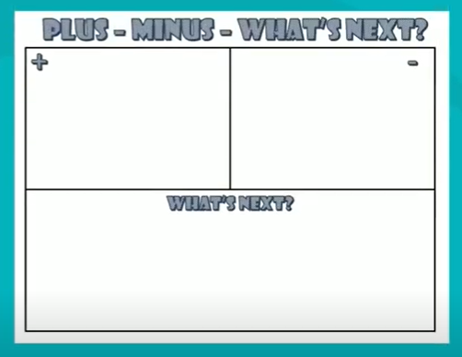
Scenario 2
Plus Minus and What’s next
Identify what has been done well and what could have been done better based on the success criteria
What’s next: can be used to set or revise personal learning goals

Slide 36
What have we gone so far in scenario-based analysis?
Toolkit 1: Feedback
Toolkit 2: Assessing Speaking
Toolkit 3: Formative Assessment
Toolkit 4: Alternative Assessment
More information on our Facebook group
Toolkit 5: Test & Test items
Toolkit 6: Item analysis

Slide 37
More training options for teachers

Slide 38
ULIS’s in-service training for professional development
Training programmes to develop teachers’ assessment literacy (CEFR & CEFR VN application, test development, item analysis)

Slide 39
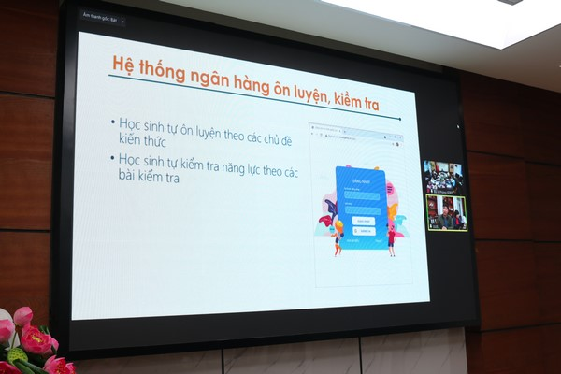
ULIS’s in-service training for professional development
Webinar to help school teachers prepare for the classroom/graduation exam (test analysis, resources for test preparation)

Slide 40
ULIS’s in-service training for professional development
Training courses for test item developers and raters of speaking and writing skills

Slide 41
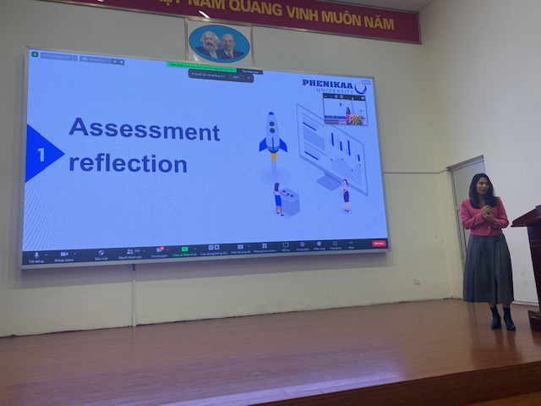
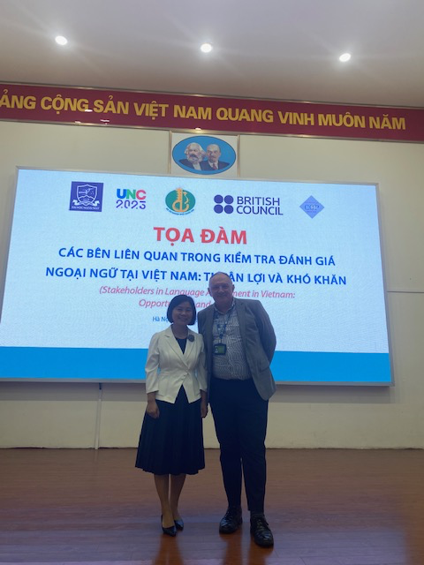
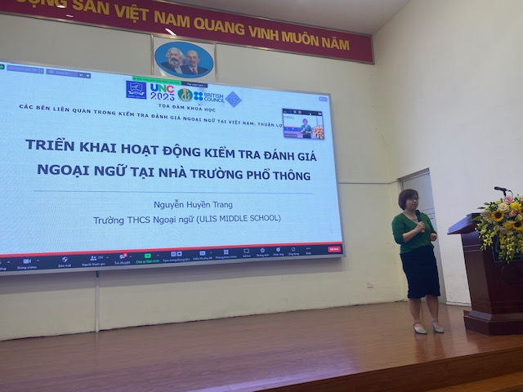
ULIS’s in-service training for professional development
Conferences, seminars, webinars in UNC series

Slide 42
Survey on the effectiveness of the toolkits and CoP
https://forms.gle/8hBmNuwaxjBh3F6v8

Slide 43
THANK YOU!

