Slide 1
Thematic discussion: the UK Quality Code
Fiona Crozier, former Head of International, QAA
24th September 2019
Notes:
This presentation template includes examples of the slides available. Select Master slides, as appropriate, to create a presentation best suited to your content and requirements. Notes are included for guidance and these should be removed before finalising. Additional guidelines are available on Qmmunity, in the QAA Brand site, along with approved images.
http://qmmunity.qaa.ac.uk/agency-resources/brand/Pages/Welcome.aspx
Title slide: A title slide must be used in all presentations.
It includes the presentation title in grey text at 40pt, and the presenter’s name and job title in 32pt.
The event title and date are both 32pt, in a colour taken from the colour palette.
Colours: This presentation template contains a pre-set colour palette which should be used consistently throughout the presentation.

Slide 2

Aim of the presentation:
To go into the UK Quality Code in more detail, in particular insofar as it relates to Partnerships (e.g. TNE)

Slide 3
What is the UK Quality Code for Higher Education?
The UK reference point for Quality and Standards in Higher Education
It offers a benchmark for process and practice for new providers
Enables providers to understand what is expected of them and what they can expect of each other

Slide 4
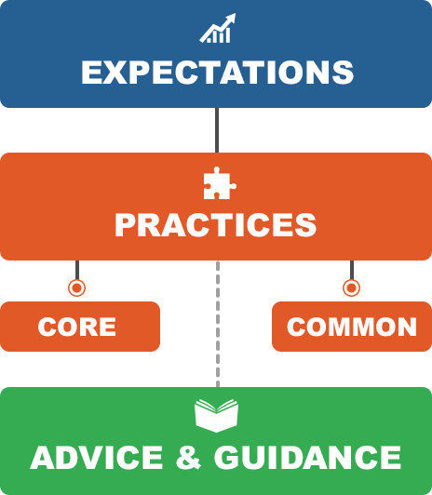
https://www.qaa.ac.uk/quality-code

Slide 5
Structure of advice and guidance
Introduction & explicit links to core and common practices
Guiding principles
Overarching Information
Practical advice and guidance on delivery of theme aims include enhancements and good practice (in particular through reflective questions)
Practical Advice & Guidance
Resources, Further Information, Relevant Organisations & Glossary
Signposting

Slide 6



Slide 7


THE CODE | Expectations (standards and quality)
 | Core practices required by all UK HE regulatory jurisdictions | Common practices common to the underpinning of quality in all UK providers but not regulatory requirements for providers in England regulated by the OfS
Supporting reference documents
National frameworks and statements (e.g. Qualifications Frameworks, characteristics statements, benchmark statements) | Advice and guidance (e.g. programme design, admissions, student engagement, etc..)
Notes:
Published on March 27 this year.
Following consultation comments hopefully you’ve noted the greater parity between core and common practices - the 2 are adjacent, distinguished only by the role of the regulator in each of the jurisdictions

Slide 8
Expectations
Standards |  | Quality
The academic standards of courses meet the requirements of the relevant national qualifications framework. | The value of qualifications awarded to students at the point of qualification and over time is in line with sector-recognised standards | Courses are well-designed, provide a high quality academic experience for all students and enable a student’s achievement to be reliably assessed | From admission through to completion, all students are provided with the support that they need to succeed in and benefit from higher education
Notes:
Final expectations – broad ranging and based on overarching principles of quality assuring HE across the UK

Slide 9
Core practices for standards The provider ensures that the threshold standards for their qualifications are consistent with the relevant national qualifications frameworks. The provider ensures that students who are awarded qualifications have the opportunity to achieve standards beyond the threshold level that are reasonably comparable with those achieved in other UK providers. Where a provider works in partnership with other organisations, it has in place effective arrangements to ensure that the standards of its awards are credible and secure irrespective of where or how courses are delivered or who delivers them. The provider uses external expertise, assessment and classification processes that are reliable, fair and transparent. | Common practices for Standards The provider reviews its core practices regularly and uses the outcomes to drive improvement and enhancement.
Notes:
It is around core practices that institutions will be measured against (certainly in England) (- RB find out for Aps) but you must bea in mind regimes in each nation will us these and the expectations as quality benchmarks
4 Core practices around standards – note that external expertise appears – and this was as a direct result of commentary through consultation

Slide 10
Expectations and practices for working in partnership
Expectations are the same as the overarching ones
Core practice for standards: ‘Where a provider works in partnership with other organisations, it has in place effective arrangements to ensure that the standards of its awards are credible and secure irrespective of where or how courses are delivered or who delivers them.’
Core practice for quality: ‘Where a provider works in partnership with other organisations, it has in place effective arrangements to ensure that the academic experience is high quality irrespective of where or how courses are delivered or who delivers them.’

Slide 11
Guiding principles
The awarding organisation will be accountable for assuring the overall quality and academic standards of the provision, regardless of the type of partnership
The awarding organisation will have in place the appropriate governance to authorise and oversee the development and closure of partnership arrangements and to monitor their effective operation
Due diligence enquiries are completed and legally binding agreements are signed prior to the commencement of student registration – due diligence enquiries are refreshed periodically and before agreements are renewed
Provision delivered through partnership arrangements will be subject to quality procedures that are at least as rigorous, secure and open to scrutiny as those used for the provision delivered by the awarding organisation
Awarding organisations that make arrangements for the delivery of learning opportunities with others, retain the authority and responsibility for awarding certificates and records of study in relation to student achievement
All awarding organisations maintain accurate, up-to-date records of all partnership arrangements that are subject to a formal agreement
Awarding organisations monitor and evaluate their partnership arrangements to satisfy themselves that the arrangements are achieving their stated outcomes and that academic standards and quality are being maintained

Slide 12
And don’t forget…
…The further resources, which include the British Council (e.g. a report on Transnational Education in Vietnam)
AND
Quadrant 3 (IQA) of the AQAF

Slide 13
So, in summary
How does the UK Quality Code ‘work’ for example in the area of partnership working?
It sets out expectations for standards and quality
It sets out practices through which the expectations might be achieved
It offers advice and guidance and resources to help providers with the expectations and the practices

Slide 14
Any Questions?

