Slide 1



Slide 2
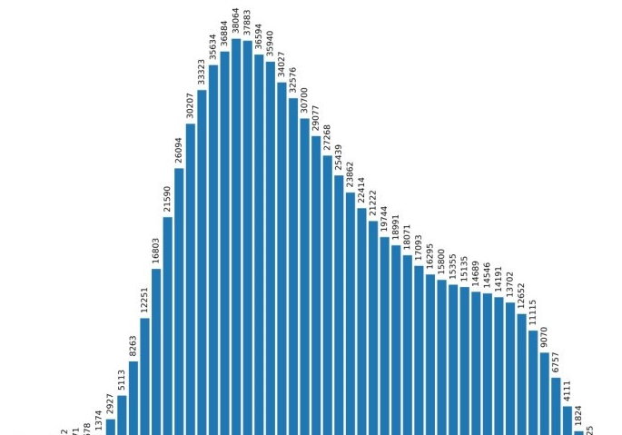
Van lang University
Source: https://nld.com.vn/giao-duc-khoa-hoc/pho-diem-thi-tot-nghiep-thpt-2022-20220724004417461.htm
“The goal is to turn data into information, and information into insight.”
- Carly Fiorina -
2022
Mean: 5.15
Mode: 3.8
Med: 4.8
Below average: 51.56%

Slide 3

UNDERSTANDING VAN LANG UNIVERSITY PLACEMENT TEST REPORTS:
A SNAPSHOT OF HIGH SCHOOL STUDENTS' ENGLISH PROFICIENCY
Speaker 1: tran nguyen bao huong, m.a
Speaker 2: nguyen Phuong thao
Van lang
University
Where
Impact matters
MAR 2023

Slide 4
Van lang University
PART 1 - Overview of the VLU Placement test
PART 2 - The development of the VLU Placement test
PART 3 - A snapshot of high school students' English language proficiency
PART 4 - Challenges faced by first-year students
PART 5 - Implications for high school educators

Slide 5

Van lang University
PART 1
1
Overview of the VLU PLACEMENT TEST

Slide 6



Van lang University
ENGLISH COURSES’ OBJECTIVES
Honored English program
Standard English program
Pre-A1 | Foundation
A1 | Level 1
A2 | Level 2
A2+ | Level 3
B1 | Level 4
B1+ | Level 5
B2- | Level 6
B2 | Level 7
Pre-A1 | Foundation
A1 | Level 1
A2 | Level 2
A2+ | Level 3
B1 | Level 4
B1+ | Level 5
B2- | Level 6
B2 | Level 7
Transforming and improving the quality of English teaching and learning
Notes:
Developing all 04 English skills (in integration), i.e. reading, listening, speaking, writing
• Developing both communicative and academic language competence
• Developing language in conjunction with authentic real-world content
• Developing 21st century skills
• Developing learning strategies to build life-long learners

Slide 7




Van lang University
LISTENING
READING
WRITING
20 QUESTIONS
MULTIPLE CHOICE QUESTIONS
30 MINUTES
.
20 QUESTIONS
MULTIPLE CHOICE QUESTIONS
30 MINUTES
.
1 QUESTION
PARAGRAPH WRITING
20 MINUTES
.
Participants: ~11,600 non-English major students
Time: September 2022
Test venue: Computer labs at Van Lang University

Slide 8
Van lang University
PART 2
2
THE development of the VLU PLACEMENT TEST

Slide 9
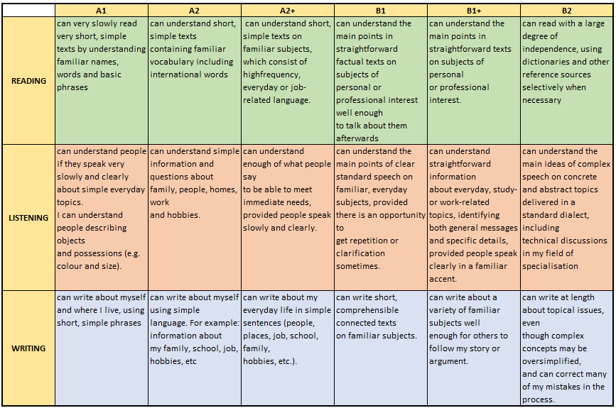
Van lang University
measuring proficiency
across skills & levels
This framework will decide:
CONTENT OF THE QUESTION
LANGUAGE INPUT
PLACEMENT TEST
CORE INVENTORY – TEACHING CURRICULA
AUTHENTIC MATERIALS
CEFR

Slide 10
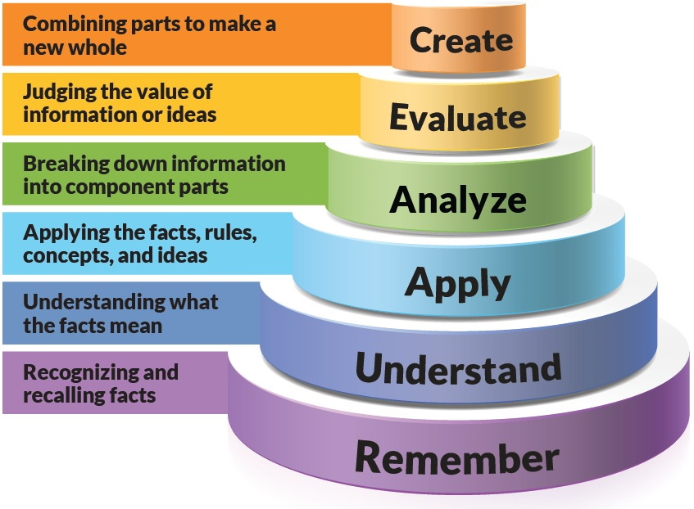
Van lang University
How to design test items
using bloom’s taxonomy
READING | LISTENING | WRITING
 |  | Write a paragraph of 120 words
 |  | Evaluate the given information (compare/ contrast, agree/disagree, problem & solution, …)
 |  | Analyze the given issue & related information to respond to the task
 |  | Use the words and grammar points appropriately to respond to the task
Inference Main idea Details Word meaning Reference | Inference Main idea Details Word meaning Attitude Opinion | Understand the vocabulary & grammar used in the question & writing response
Vocabulary Grammar

Slide 11
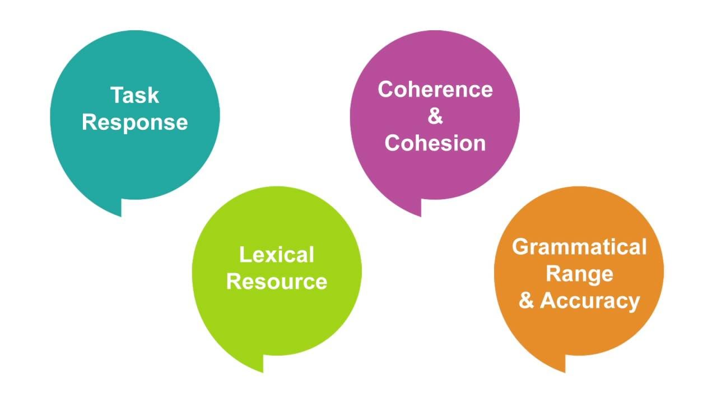
Van lang University
THE DEVELOPMENT OF WRITING TEST
A1 | A2 | A2+ | B1 | B1+ | B2
HOLISTIC WRITING RUBRIC

Slide 12

Van lang University
PART 3
a snapshot of high school students' English language proficiency
3

Slide 13
Van lang University
Students' distribution across CEFR levels
Pre-A1 | 464 | 4%
A1 | 6810 | 59%
A2 | 2312 | 20%
A2+ | 1295 | 11%
B1 | 584 | 5%
B1+ | 92 | 1%
Total | 11557 | 100%

Slide 14
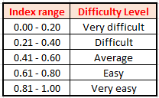
Van lang University
DIFFICULTIES FACED BY HIGH SCHOOL STUDENTS
Higher-order thinking skills
A strong vocabulary base
Interpreting tone, intonation
Analyzing complex language structures and ideas

Slide 15
Van lang University
PRODUCTIVE SKILL - WRITING
Mean | 4.2
Standard Error | 0.1
Median | 3.33
Mode | 0
Standard Deviation | 5.2
Length: 10 – 49 words
Clarity: Unclear content
Sentence structure: Not logical
Cohesion: No cohesive devices
Vocabulary: Little appropriate use
Grammar: Little appropriate use
48%

Slide 16
Van lang University
Date 2022
Van lang University
PART 4:
CHALLENGES FACED BY FIRST-YEAR STUDENTS
4

Slide 17
SOME CONSIDERATIONS FROM THE INTERPRETATION
OF PLACEMENT TEST RESULTS & THE SURVEY OF COMMON CHALLENGES
OF K28 NON-ENGLISH MAJOR FRESHMEN
LISTENING SKILL
READING SKILL
WRITING SKILL
SPEAKING SKILL
A2 → B1-
Students have difficulties in recognizing inferences, main ideas, and opinions in reading and listening.
Length: 10 – 49 words
Clarity: Unclear content
Sentence structure: Not logical
Cohesion: No cohesive devices
Vocabulary: Little appropriate use
Grammar: Little appropriate use
Psychology: Shyness, Anxiety
Linguistic components (Pronunciation, Grammar, Vocabulary)
Lack of social knowledge
14% OF VLU STUDENTS ARE REPORTED TO ENCOUNTER DIFFICULTIES IN THE EFL COURSE IN THEIR FIRST YEAR.
Students have difficulties in:
Following the lesson in 100% English instruction.
E-learning exercises (IELTS 6.0 oriented) (The audio is too fast; There are many unfamiliar topics in reading.)
Giving presentations in English (Project-based assessment)
Writing (Lack of vocabulary and grammar).
Workload management, teamwork, time management…

Slide 18


ENTRY LEVEL
OUTCOMES
LISTENING & READING SKILLS
A2 → B1-
Students have difficulties in recognizing inferences, main ideas, and opinions in reading and listening.
PROGRAM LEARNING OUTCOMES
COURSE LEARNING OUTCOMES
WRITING SKILL
EXTRA CURRICULUM
Length: 10 – 49 words
Clarity: Unclear content
Sentence structure: Not logical
Cohesion: No cohesive devices
Vocabulary: Little appropriate use
Grammar: Little appropriate use
ACADEMIC CURRICULUM
MATERIALS
SELF-REGULATION
FOR ENGLISH LANGUAGE LEARNING
SPEAKING SKILL
INSTRUCTION
Psychology: Shyness, Anxiety
Linguistic components (Pronunciation, Grammar, Vocabulary)
Lack of social knowledge
STUDENT SUPPORT
ENVIRONMENT

Slide 19
PART 5:
SOME RECOMMENDATIONS FOR HIGH SCHOOL EDUCATION
Van lang
University
Where
Impact matters
Date 2022

Slide 20



A NEW DIRECTION IN FORMATIVE ASSESSMENT
Project-based learning
Role-play
Visual Arts
Interview
Shark Tank
MIDTERM TEST
“I am excited to carry out the project-based assessment in place of the midterm test.” (4.32/5)

Slide 21


IMPLEMENTING PROJECT-BASED ASSESSMENT ACTIVITIES IN HIGH SCHOOLS
TEACHERS
Workshops or professional training courses
Sharing from teachers and colleagues
STUDENTS
Fundamental self-regulation learning strategies
21st Century skills for global citizens
Project-based assessment: Purposes & Pedagogical understanding & Benefits

Slide 22



IMPLEMENTING PROJECT-BASED ASSESSMENT ACTIVITIES IN HIGH SCHOOLS
The support from stakeholders (MOET, City, Province)
Exhibition and forums of project-based assessment products
Curriculum design
MOOCs for training

Slide 23


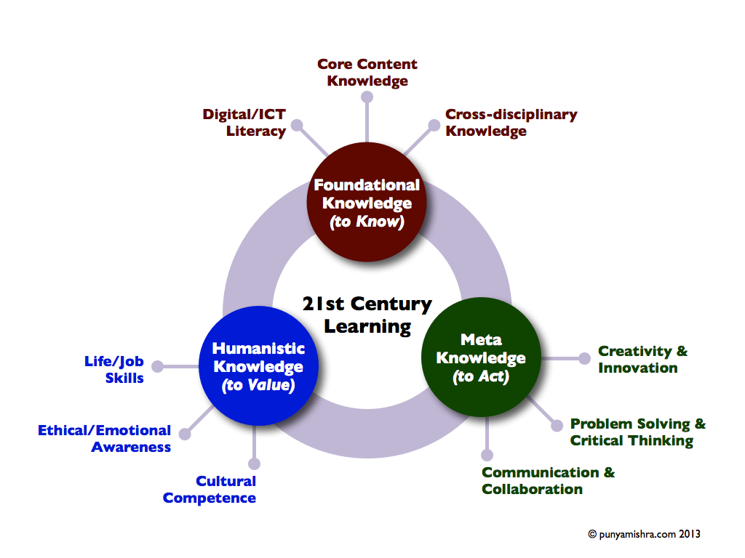

1. WHERE OUR STUDENTS STAND BEFORE THE TERTIARY LEVEL
2. WHAT THE UNIVERSITY REQUIRES OUR STUDENTS

Slide 24


“IF WE ARE TRULY EFFECTIVE TEACHERS, THEN WE ARE CREATING AUTONOMOUS, INDEPENDENT, AND
SELF-DIRECTED LEARNERS.”
Robert john meehan
Trần Nguyễn Bảo Hương: huong.tnb@vlu.edu.vn
Nguyễn Phương Thảo: thao.nguyenphuong@vlu.edu.vn
Van lang
University
Date 2022

