Slide 1
POST-PANDEMIC DIRECTIONS FOR LANGUAGE ASSESSMENT IN VIETNAM SCHOOLS: INTRODUCING GRADE-BASED ENGLISH TARGETS TO CONNECT SUMMATIVE AND FORMATIVE ASSESSMENT
Duong Thu Mai, Ph.D University of Languages and International Studies

Slide 2
Contents
General contexts of language assessment in Vietnam’s schools
Part 1: Specifying English assessment targets from curriculum outcomes
Part 2: Providing specific guidance on the assessment tasks for each target
Part 3: Giving meaningful and kind feedback to students.

Slide 3
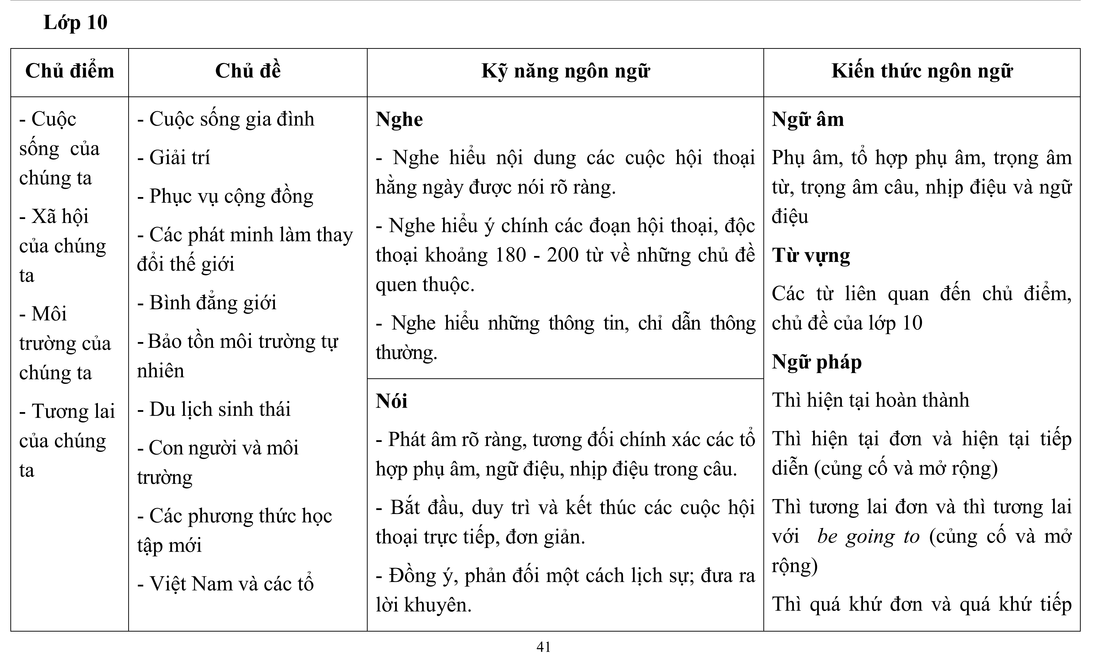
Language assessment in Vietnam schools after the Covid pandemic
The English curriculum framework 2018 with general outcomes for 12 grades and general guidelines for conducting assessment
Little is known about the teachers’ language assessment practices in the new curriculum during the Covid pandemic
Grade 10 outcomes for listening:
Listen to contents of everyday conversations
Listen and understand key contents of 180-200 word conversations on familiar topics
Listen to understand common information and instruction

Slide 4
Contexts of language assessment practices in Vietnam schools after the Covid pandemic
- The use of multiple series of textbooks for English education in 12 grades

Slide 5
Assessment literacy for Vietnamese teachers in the new curriculum (proposed in 2019)

Slide 6
STANDARDS FOR ENGLISH TEACHERS’ COMPETENCES IN VIETNAM (updated in NFLP 2022)
3.Using knowledge about learners
2.Using language teaching methods
1.Using target language use
5.Promoting the value of language use and professionalism in language teaching
4.Using knowledge of contexts in teaching language
Competence 2.4: Language assessment
“Teachers can design and use assessment instruments to collect evidence of students’ target language use, then make valid decisions on students and teaching contents”

Slide 7
Circular 26 and 27 for conducting educational assessment (2020)
Teachers can administer more methods of language assessment: projects, presentations, experiments, etc.
Each assessment should have clear specifications
Performance-based method need to provide clear guidance and scales.
Teachers’ comments and feedback on students’ progress and achievements of curriculum outcomes are encouraged besides grades and scores

Slide 8
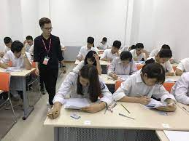
Teachers’ assessment practices in Vietnam schools in the new curriculum
Tests tend to be the more popular methods of formal language assessment
Slow changes in the adoption of other methods for productive skill assessment
Teachers’ limited assessment knowledge and their challenges to connect the teaching and assessment contents (Nguyen Thi Hong Nhat et al, 2023).
Source of image: FPT education

Slide 9
Noteworthy issues in realizing the policies
The outcomes for English learning and teaching are general
->Targets for both summative and formative assessment are not consistently understood by teachers
2. Limited information on how the grade-based outcomes can be matched with suitable assessment methods
3. Summative assessment at the end of year based on the outcomes but formative assessment cannot
4. Giving formative feedback based on the curriculum outcomes can be hard.

Slide 10
Project 1: Formative assessment guidelines for K3-K12 in Vietnam (Cambridge Assessment)
Defining the nature and reasons for formative assessment
Planning Formative Assessment
Learning as a journey
Responsive teaching and assessment
Involving learners
Building a Growth mindset for learners
Reflective Practice

Slide 11
Products of Project 1: Formative assessment guidelines for K3-K12 in Vietnam (Cambridge Assessment)
General manuals for formative assessment in
Primary schools
Secondary schools
High schools
Manuals for each grade from Grade 3 to Grade 12

Slide 12
Project 2: Specifying assessment standards of English curriculum 2018 to support teachers in summative and formative assessment
Phase 1: Developing specific grade-based assessment targets
Phase 2: Providing assessment alternatives and specific examples of them to assess each target
Phase 3: using the grade-based assessment targets to connect formative and summative assessment

Slide 13
Common directions in both projects

Slide 14
1.Specifying assessment targets for each grade for both formative and summative assesment
2.Introducing a range of assessment methods for summative and formative assessment with specific examples to suit each target
3.Developing formative and summative assessment instruments relating to the target

Slide 15
1: Specifying curriculum outcomes into assessment targets

Slide 16
What are learning and assessment targets?
Specific skills or tasks students are able to do after a period of learning that can be used as evidence for making inferences on their competence

Slide 17
Why do we need specific targets?
General outcomes may be understood differently by different teachers
Specific targets support teaching and assessment in different cycles
Beginning of semester
Middle of semester
End of semester

Slide 18
What do “assessment targets” look like?
An assessment target
Performance level
Knowledge / skills for a competence
Condition for performing
Criteria
specific
measurable
appropriate
relevant

Slide 19
Assessment targets for curriculum 2018
Specific to the domains (topics, genres, tasks, text length, contexts, etc) in the English curriculum in Vietnam
Measurable (realized by observable performances)
Appropriate (to curriculum contents and characteristics and involved people’s characteristics)
Relevant (to curriculum contents and characteristics and involved people’s characteristics
Plausible for teaching and leaning
Consistent and progressive across and within school levels
Defendable against currently accepted learning, assessment principles and policies
Worded with a language comprehensible for teachers and learners (Vietnamese and English)

Slide 20
From general grade-based outcomes to specific assessment targets
Drafting of the targets for each grade
Paneling the targets among the team members
Paneling the targets among 200 in-service teachers
Revising the targets
Research team (5 members):
Vietnamese experts in English language teaching, Language assessment, Education Measurement
University lecturers for TESOL and TEFL students
Textbook writers
20-30 years of experience in ELT

Slide 21
From general grade-based outcomes to specific assessment targets - Writing
Drafting of the targets for each grade for writing from the general outcomes of writing
Paneling the targets among the team members on the validity of the writing construct for each genre
Panelling the targets in 4 workshops with experts from MOET
Survey the opinion of 200 in-service teachers on the targets
Revising the targets
Paneling partipants: 20
Positions: key staffs of MOET in language assessment, university lecturers, teachers in highschool.

Slide 22
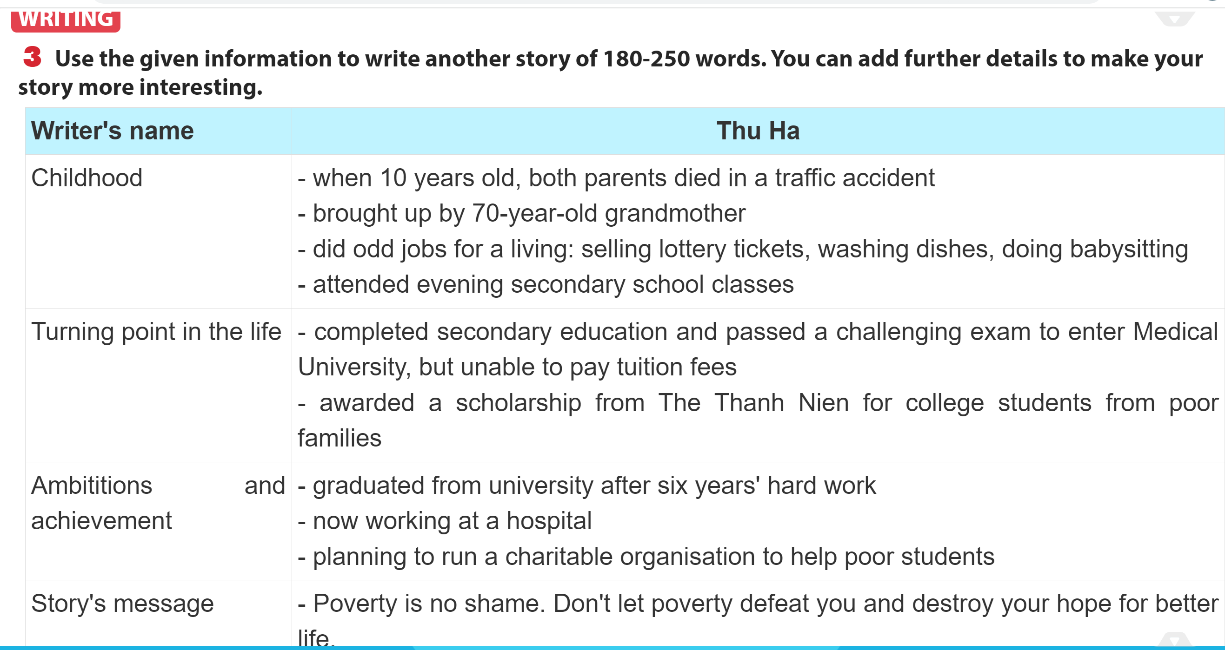
Grade 12 writing lessons: Example from Global Success textbook
Grade 12 general writing outcomes:
Write a composition of 180-200 words on a familiar issue; write a report; write a simple chart and graph description.
Initial draft of writing assessment targets
Provide a relevant response of adequate length on a familiar topic
Organize ideas logically in the composition
Use a range of familiar vocabulary in the composition
Use a range of familiar grammatical knowledge in the composition

Slide 23
Examples of final products for each grade
Linguistic knowledge
Vocabulary competence (3)
Grammar competence (3)
Pronunciation competence (3)
Listening competence
5 targets
Reading competence
5 targets
Writing competence
5 targets
Speaking competence
6 targets

Slide 24
Grade 5: grammar competence: an assessment target for grammar knowledge usage
Indicators: the use of grammatical knowledge in the curriculum for grade 5 in individual sentences.
Performance level | Description
Not achieved | Students face many challenges and cannot use the learnt grammar knowledge in sentences in the curriculum outcomes for grade 5
Achieved | Students can use fairly exactly in sentences the learnt grammar knowledge in the curriculum outcomes for grade 5
Well achieved | Students use exactly within sentences the learnt grammar knowledge in the curriculum outcomes for grade 5

Slide 25
Grade 9: an assessment target for pronunciation
Indicators: the use of sounds (monothong and dipthong vowels and consonants) and combinations of sounds instructed in the curriculum for grade 9
Performance levels | Description
Not achieved | Students cannot recognize or recognize with limited accuracy the pronunciation of sounds and sound combinations learnt in individual words of topics in the curriculum outcomes for grade 9
Achieved | Students can use fairly accurately the pronunciation of sounds and sound combinations learnt in individual words of topics in the curriculum outcomes for grade 9
Well achieved | Students can use with relatively high level of accuracy the pronunciation of sounds and sound combinations learnt in individual words of topics in the curriculum outcomes for grade 9
Distinctively achieved | Students can use with high accuracy the pronunciation of sounds and sound combinations learnt in individual words of topics in the curriculum outcomes for grade 9

Slide 26
Grade 10 assessment target for speaking
Indicators: the use of speech acts instructed in the curriculum for grade 10 in Grade 10 speaking discourses (conversations, discussions, presentations)
Performance levels | Descriptions
Unachieved | Students cannot perform or perform very few of the familiar speech acts instructed in the Grade 10 currilum in Grade 10 speaking discourses
Achieved | Students can perform fairly accurately the familiar speech acts instructed in the Grade 10 currilum in Grade 10 speaking discourses
Well achieved | Students can perform with fairly high level of accuracy the familiar speech acts instructed in the Grade 10 currilum in Grade 10 speaking discourses
Distinctively achieved | Students can perform with fairly high level of accuracy the familiar speech acts instructed in the Grade 10 currilum in Grade 10 speaking discourses

Slide 27
Grade 10 assessment targets for reading
Indicators: understanding gists (purposes, title, theme, topic, tone, attitude, source materials) in a contemporary and everyday topics in Grade 10 curriculum despite the clear structure, straightforward and simple language expression
Performance levels | Descriptions
Unachieved | Students scarcely understand the gist of 220-250 word texts on a contemporary and everyday topics in Grade 10 curriculum despite the clear structure, straightforward and simple language expression
Achieved | Students understand fairly accurately the gist of 220-250 word texts on a contemporary and everyday topics in Grade 10 curriculum despite the clear structure, straightforward and simple language expression
Well achieved | Students understand with a relatively high level of accuracy the gist of 220-250 word texts on a contemporary and everyday topics in Grade 10 curriculum despite the clear structure, straightforward and simple language expression
Distinctively achieved | Students understand with a high level of accuracy the gist of 220-250 word texts on a contemporary and everyday topics in Grade 10 curriculum despite the clear structure, straightforward and simple language expression

Slide 28
Designing assessment methods to assess each target

Slide 29
Suggested methods of assessment
Cambridge Assessment Project – Project 1: more applicable for both informal and formal formative assessment
Methods for short cycle of assessment
Methods for medium cycle of assessment
Methods for long cycle of assessment
Vietnamese experts’ Project –
Project 2: more applicable for formal formative and summative asssessment
Selected response: MCQ, T/F, matching
Limited response: cloze, short answers
Constructed response: paragraphs, emails, reports, narrative, essays, portfolios, presentations, debates, projects

Slide 30
 | Selected response | Limited response | Constructed response
Vocabulary competence | MCQ, TF, matching, | Cloze, short answer, close elide | Short answer, compositions, presentation, projects
Grammar competence | MCQ, TF, matching | Cloze, short answer | Short answer, compositions, presentations, projects
Pronunciation competence | MCQ, TF, matching | Cloze, short answer, close elide | Short answer, compositions, presentation, projects
Listening competence | MCQ, TF, matching, | Cloze, short answer | Short answer, compositions, presentations, projects
Reading competence | MCQ, TF, matching | Cloze, short answer, close elide | Short answer, compositions, presentation, projects
Speaking competence | MCQ, TF, matching | Cloze, short answer | Short answer, compositions, presentations, projects
Writing competence | MCQ, TF, matching | Cloze, short answer, close elide | Short answer, compositions, presentation, projects

Slide 31
Suggesting the method for each target
Grade 10: Writing competence 1: organize ideas logically in a composition of 120-150 words in a familiar topic.
Levels | Description | Possible assessment methods | Sample item (Email)
Unachieved | Students can hardly organize ideas logically in the different genres of writing on familiar topic in Grade 10 curriculum | Composition writing (emails, paragraphs, reports, essays) | Situation: Your close friend participated in a volunteer project and went to a a poor area in Lao Cai to teach English in the summer for children. Instruction: Please write an email to him/her and ask about his/her life in the voluntary project. You should write about: Your summer activities. The tasks your friend has to do in the project. The places and people he/she met in the project His/her feelings about the trip. The email is about 120-150 words.
Achieved | Students can organize ideas quite logically in the different genres on familiar topics of writing in Grade 10 curriculum
Well achieved | Students can organize ideas with a relatively high level off logic in the different genres on familiar topics of writing in Grade 10 curriculum
Distinctively achieved | Students can organize ideas with a high level of logic in the different genres on familiar topics of writing in Grade 10 curriculum

Slide 32
Using the specified assessment targets to connect summative and formative assessment

Slide 33
Point 1: Adapting final-year target to use during the year
Select the targets most applicable to the teaching of a specific competence (speaking, writing) in the context
Adjust the types of topics and genres in the target to match the learned contents
Adjust the expected outcome levels for the first semester to reach “good” rather than “excellent”

Slide 34
Example scenario: If you only have taught essays, not other genres of writing
Summative assessment target
Formative assessment target
…in the different genres of writing
…in writing a paragraph

Slide 35
Point 2:Developing assessment specifications for formative and summative assessment
Current assessment targets in most test specifications are content-based with adapted Bloom’s taxonomy levels of performance
The described assessment targets and tasks can be used to form assessment specifications
Assessment targets | Task and input features | Type | Number of items | Score
Read for main ideas in a variety of reading discourses in Grade 10 curriculum | A narrative text on a familiar topic of 200 words on familiar topics given the texts are clearly structured and straightforward idea expression | Multiple choice question | 2 (title and attitude) | 2

Slide 36
Point 3: Developing rating scales for productive skills
Steps to develop rating scales from the targets to use for formative and summative assessment of speaking and writing
Select the most relevant assessment targets
Create a table and copy-paste the relevant assessment targets in the step 1
Adapt the list of text types/genres in the targets to only include those instructed

Slide 37
Example scale for marking writing in grade 10
 | Unachieved | Achieved | Well achieved | Distinctively achieved
Produce the correct format of the task and reach the required length (120-150w) | Students struggles and cannot write a composition according to the required format and length on a familiar topic in grade 10 curriculum | Students can write a composition which is fairly accurate in the format and fairly meet the required length on a familiar topic in Grade 10 curriculum | Students can write a composition which is of relative high level of accuracy in the format and highly meet the required length on a familiar topic in Grade 10 curriculum | Students can write a composition which is highly accurate in the format and totally meet the required length on a familiar topic in Grade 10 curriculum
Developing contens | Students cannot develop appropriate and relevant contents for the different genres of writing in Grade 10 curriculum | Students can develop fairly appropriate and relevant contents for the varied genres of writing discourses in Grade 10 curriculum | Students develop contents with a relatively high level of appropriateness and relevance for the varied genres of writing discourses in Grade 10 curriculum | Students develop contents with a high level of appropriateness and relevance for the varied genres of writing discourses in Grade 10 curriculum
Organising ideas | Students can hardly organize ideas logically in the different genres of writing on familiar topic in Grade 10 curriculum | Students can organize ideas quite logically in the different genres on familiar topics of writing in Grade 10 curriculum | Students can organize ideas with a relatively high level off logic in the different genres on familiar topics of writing in Grade 10 curriculum | Students can organize ideas with a high level of logic in the different genres on familiar topics of writing in Grade 10 curriculum
Using familiar vocabulary | Students struggle to use a variety of simple vocabulary to produce compositions in different genres of writing on familiar topics in grade 10 curriculum | Students use quite accurately a variety of simple vocabulary to write different genres of writing on familiar topics in grade 10 curriculum | Students use with a relative high level of accuracy a variety of simple vocabulary to write different genres of writing on familiar topics in grade 10 curriculum | Students use with a high level of accuracy a variety of simple vocabulary to write different genres of writing on familiar topics in grade 10 curriculum
Using grammar knowledge | Students can hardly use the learnt basic grammar knowledge to produce compositions in different genres of writing on familiar topics in grade 10 curriculum | Students can use quite accurately the learnt basic grammar knowledge to produce compositions in different genres of writing on familiar topics in grade 10 curriculum | Students can use with relative high level of accuracy the learnt basic grammar knowledge to produce compositions in different genres of writing on familiar topics in grade 10 curriculum | Students can use with high level of accuracy the learnt basic grammar knowledge to produce compositions in different genres of writing on familiar topics in grade 10 curriculum

Slide 38
Point 4: Giving personalized and meaningful feedback and feedforward
Feedback can become personalized
Feedback can become meaningful: Students’ competence can not only be reflected by a score in a test, but with a profile of the targets they have achieved and those they haven’t.
Students can see the description of the next level they should aim forward
- A growth mindset can be nurtured

Slide 39
Giving criterion-referenced feedback to students
Students’ sample writing grade 10
My family lives in the alley with some other families. Everyone in the alley is living happily together ,but the families also have different characteristics ,especially the difference between my to neighbors :Mrs Thanh and Mrs Nhung .while Mrs Thanh is quiet person ,Mrs Nhung is a person who talks a lot .In the evening ,when Mrs Nhung is playing volleyball game ,Mrs Thanh is a watching TV program .If you have not know each other for a long time ,you will easily feel that Mrs Thanh is quiet difficult to appoach ,and Mrs Nhung is a frendly person .Mrs Thanh is a mental worker ,Mrs Nhung is a manual worker .Mrs Nhung is a person who works in a simple way ,while Mrs Thanh works in a complex .Mrs Nhung is an easy person to forgive ,but Mrs Thanh is difficult to forgive the mistakes of other .Although their personalities and lifestyles are different ,I love and respect both of ,so our alley is always full of laughter.
Sample summative feedback:
Students can write a composition which is fairly accurate in the format and fairly meet the required length on a familiar topic in Grade 10 curriculum
Students can develop fairly appropriate and relevant contents for the varied genres of writing discourses in Grade 10 curriculum
Students can organize ideas quite logically in the different genres on familiar topics of writing in Grade 10 curriculum
Students use quite accurately a variety of simple vocabulary to write different genres of writing on familiar topics in grade 10 curriculum
Students can use quite accurately the learnt basic grammar knowledge to produce compositions in different genres of writing on familiar topics in grade 10 curriculum

Slide 40
Aspirations and guarantee conditions

Slide 41
Aspirations
Teachers’ workload can be reduced by using the framework of assessment targets in planning their lessons and designing assessment plan, assessment task specifications, scales and rubrics
Teachers can suggest and provide more examples for assessment methods which can be realized for each target
Students can receive meaningful formative feedback and final feedback basing on what final-year targets they have achieved
Formative and summative assessment can be strongly connected.

Slide 42
Guarantee conditions
Stronger support from policy makers in encouraging both test and non-test formative assessment alternatives
Actual usage of the project products by teachers and learners (2 projects in this presentation)
Frequent back-up of more examples from the variety of textbooks
Training on assessment targets and assessment methods for teachers in different series of textbook, which is a good condition for the new curriculum implementation (Mandukwini, 2016).

Slide 43
To recap
Contexts of language assessment in Vietnam
Part 1: Specifying English assessment targets from curriculum outcomes
Part 2: Providing specific guidance on the assessment tasks for each target
Part 3: Giving meaningful and kind feedback to students.

Slide 44
THANK YOU FOR LISTENING!

Slide 45
Please help us comment on the project with this small poll
mentimeter

