Slide 1
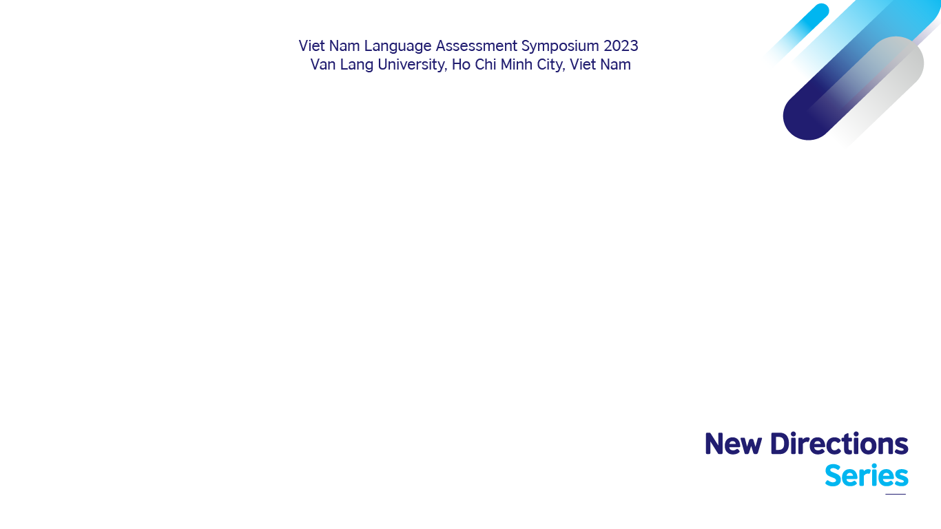
Assessing language learners in an extended time of uncertainty
Pham Thi Hong Nhung
Hue University of Foreign Languages and International Studies

Slide 2
In this talk
The national English language curriculum of Vietnam
The new assessment guide
The implementation of the new curriculum
Language assessment in the pandemic time
The lessons learnt on the implementation level
Implications

Slide 3
The National English Language Curriculum
MOET Circular No. 32/2018/TT- BGDDT (The 2018 curriculum)
Representing a fundamental change in the philosophy
Major changes in objectives of general education:
        The shift to student-centered teaching
        The shift to learning-oriented assessment
        The emphasis on students’ personal development
        Moving to a concern for how the learnt knowledge and skills relate to the life worlds

Slide 4
English Language Curriculum
Objectives
  To achieve levels of proficiency in The 6-level Framework of Reference for Foreign Languages for Vietnam (V-CEFR);
  To understand and respect the diversity and differences of cultures;
  To use English to learn other subjects better;
  To use English to pursue further learning aims or for work after high school graduation… (MOET, 2018, pp. 5-6)

Slide 5
English Language Curriculum
Required learning outcome
Standard- based learning outcome
Primary education:
        Grades 1-2: English as an elective subject
        Grades 3-5: level 1/A1 (420 prds.)
    Lower secondary: Grades 6-9: level 2/A2 (420 prds.)
    Upper secondary: Grades 10-12: level 3/B1= (315 prds.)

Slide 6
English Language Curriculum
Teaching contents
  Themes & Topics: Suggestive
  Language functions
  Language contents:
    Phonics/pronunciation
    Vocabulary: Topic-based & Proficiency level-based
    Grammar: Proficiency level-based & suggestive

Slide 7
English Language Curriculum
Methodology
Communicative Language Teaching as an approach
Student-centered
Roles of the teacher: Educator, advisor, participant, learner/researcher
Roles of students: Negotiator, participant

Slide 8
English Language Curriculum
Assessment
A shift to learning-oriented assessment
        Emphasizing on the use of assessment to facilitate learning
        Emphasizing feedback use
        Suggesting involving learners in assessment
        Emphasizing both on learners’ progress and proficiency development
Highlighting the use of a variety of assessment tasks

Slide 9
Preparation for Implementation
In-service education
Investments in instructional support
Textbook appraisal
Textbook choices available: “One curriculum, many textbooks”
MOET Instructions/Directives

Slide 10
MOET Instructions on Assessment
    For primary education:
      Assessing the qualities and competences of learners as directed in the 2018 curriculum, focusing on developing confidence for learners (MOET, 681/BGDĐT-GDTH dated 4/3/2020);
      Circular No. 27/TT 2020/TT-BGDĐT dated 9/9/2020 ref assessment guide for primary school pupils.
    For secondary education:
      Circular No. 26/2020/TT-BGDĐT dated 26/8/2020 ref amendments to Circular No. TT 58/2011-TT-BGDĐT dated 12/12/2011;
      Circular No. 22/2021/TT-BGDĐT dated 20/7/2021 ref assessment guide for secondary school students.

Slide 11
MOET Instructions on Assessment
    Circular No. 27/TT 2020/TT-BGDĐT ref assessment guide for primary school pupils
      General guide
      Learning-oriented assessment:
        Providing accurate, timely information on students’ progress and learning achievement
        Providing information for teachers’ teaching
        Providing information for students’ self assessment and self-regulated learning
        Assessing students’ progress and for students’ progress and autonomy in learning
        Assessment for encouraging students to learn
        (MOET, 2020, pp.2-3)
    Assessment plan: 2020-2021; 2021-2022; 2022-2023; 2023-2024, 2024-2025

Slide 12
MOET Instructions on Assessment
    Circular No. 22/2021/TT-BGDĐT ref assessment guide for secondary school students
      General guide
      Learning – oriented assessment
      Assessing for students’ progress and learning
      Referring to the (2018) national curriculum as point of reference in assessment
        Assessing in reference to the required learning outcome desribed in the national curriculum
        Assessing following the required learning outcome desribed in the national curriculum
      (MOET, 2021, p. 2-3)
      More specific guide on summative assessment

Slide 13
What do we learn about curriculum and assessment reform?
Local context is not considered in curriculum development (Carson, 2009)
Requiring a drastic change (Yan & He, 2012)
Complicated, chaotic, painful and unpredictable (Fullan, 2001)
Depending largely on teachers’ willingness and abilities (Blignaut, 2007)
Student voice remains “remarkably absent” in assessment (Brown, 2021)
The key aim of classroom assessment is to promote productive student learning (Carless, 2009, p. 80) and to empower them to continue learning independently outside the classroom (Baker et al., 2021) but for language learning-oriented assessment, the difficulty lies in its implementations (Saville, 2021; Jin, 2023)

Slide 14
What is the uncertainty? – Existing problems (2019)
Uncertainty of how to make use of assessment results to improve teaching and learning
Uncertainty of how to link assessment results with the required standard-based learning outcome
Uncertainty in assessing in alignment with the required learning outcome (mainly imitating A1, A2, B1 test task format)

Slide 15
What makes it even more challenging?
One curriculum, many new textbooks
The pandemic:
      Same time as the implementation of the new curriculum:
    2019: grade 1 => School year: 2020-2021
    2020: grade 2, 6 => School year: 2021-2022
    2021: grade 3, 7, 10 => School year: 2022-2023
      Interrupting all in-service education
      Adding more uncertainty and confusion

Slide 16
The Data
Coming from a larger, ongoing project on school teachers’ perceptions and reflections
Focusing on primary and lower secondary school teachers
      Implementing the 2018 curriculum as same time as the pandemic;
      Teaching and assessing their students following general, new guide;
      Attending training workshop(s) on the new curriculum and assessment in blended mode.
    Collected via post-training survey and in-depth interview

Slide 17
What have the teachers learnt?
Students’ learning comes first, before formal assessment.
“During the covid time, helping students learn was more important than anything else. It’s much more important than [formal] assessment or testing [kiểm tra hay thi cử] or anything.”
“Getting students online and safe was most important.”
“I didn’t think of tests or assessment as much as getting my students online and teaching as planned.”
“I really had no time to think about [formal] assessment until the end [of the semester]. My biggest concern was getting students to learn.”

Slide 18
What have the teachers learnt?
Assessment is a constant process.
I used to think assessment should be done at some specific points of time in our teaching but now I think that is just true for formal assessment. At the unexpected outbreak of the pandemic we had to teach all online […] I had to constantly observe all the time to respond to students’ needs in a timely manner, to see if they were really there, if they were safe and needed help [for example, to provide further explanations]. When all we saw was students’ face [on the screen] and many times we only heard their voice, we got to assess if they were with us, if they were learning all the time.
So assessment actually started as soon as we turned the computer on. Thanks to this observation, I could see students’ reactions and so I could change my [teaching] methods and activities properly. It turns out that we assess all the time for teaching.

Slide 19
What have the teachers learnt?
Assessment may involve factors beyond the current, prescribed list of rubrics and criteria.
We were not trained to asses students completely online. Sometimes, I felt like we tested students just for the sake of testing, to get it done. We didn’t really know what they were doing at the other end or who were really doing the test or if they heard clearly [the listening task] on their end or even if they were in [the internet] range.
Also when students were speaking [online], criteria for assessing speaking in face to face mode sometimes could not be used. For example, interaction in face to face mode is not the same as interaction when the student is talking online. So some students became shy and did not speak as well as they normally would. The same for writing. […] We were not prepared for this [assessing online] and neither were our students, so a lot must be done.

Slide 20
What have the teachers learnt?
Classroom assessment involves not just contextual but also situational decisions.
When we taught and assessed students [in the pandemic], many things could happen and many things we were not certain about. Anything could become a source of anxiety and confusion [e.g. technology, concern for students’ safety, internet connection, students being unfamiliar with being assessed online,…]. So we had to make decisions depending on the situation. For example, the test [plan] was having students listen twice but then for some technical problem, I could let students listen for the third time….Or it may take more time for students to type, so I gave them a couple of minutes more… Or some students felt uncomfortable speaking to me [the teacher, online], then I had to support them more [asking simpler questions and encouraging them].

Slide 21
So what is certain in a time of uncertainty?
Learning > Assessment
Assessment is not a choice. It is a must.
Language assessment involves far more complicated factors (e.g. situational factors).
Teaching requires making constant situational decisions and so does classroom assessment.

Slide 22
Implications
More support for teachers
      Training:
        Making use of assessment results
        Involving learners in assessment process
        Making situational assessment decisions to support learning
        Providing more external resources for assessment (apart from in-school resources)
Rethinking interactiveness of assessment tasks
Rethinking criteria for assesment (online)

Slide 23
References
1. Baker, B., Polikar, S., & Homayounzadeh, M. (2021). “I was not thoughtful enough before”: Exploring the learning-oriented-assessment potential of a test-taker-oriented rubric for summative assessment. In A. Gebril (Ed.), Learning-oriented language assessment: Putting theory into practice (pp. 162–181). Routledge.
2. Blignaut, S. (2007). The policy-practice dichotomy: Can we straddle the divide? Perspectives in Education 25(4), 49-61.
3. Brown, G. T. L. (2021). Student conceptions of assessment: Regulatory responses to our practices. ECNU Review of Education, 5(1), 1–24.
4. Carless, D. (2009). Trust, distrust and their impact on assessment reform. Assessment & Evaluation in Higher Education, 34(1), 79–89.
5. Carson, T. (2009). Re-thinking curriculum change from the place of the teacher: Teacher identity and the implementation of curriculum reform in China. In T. Autio & E. Ropo (Eds.), Reframing curriculum discourses: Subject, society and curriculum (pp.) . Rotterdam: Sense Publishers.
6. Fullan, M. (2001). The new meaning of educational change (3rd ed.) London: RoutledgeFalmer.
Jin, Y. (2023). Test-taker insights for language assessment policies and practices, Language Testing, 40(1), 193-203.
7. Saville, N. (2021). Learning-oriented assessment: Basic concepts and frameworks in using assessment to support language learning. In A. Gebril (Ed.), Learning-oriented language assessment: Putting theory into practice (pp. 13–33). Routledge.
8. Yan, C., & He, C. (2012) Bridging the implementation gap: an ethnographic study of English teachers' implementation of the curriculum reform in China. Ethnography and Education, 7(1), 1-19.

Slide 24
Q & A
Questions and comments?
Email: n.pham@hueuni.edu.vn

