Slide 1
TEACHERS' PERSPECTIVES AND IMPLICATIONS
LANGUAGE ASSESSMENT AT SCHOOLS IN VIETNAM
Nguyen Thanh Binh, PhD
Ho Chi Minh City University of Education

Slide 2
CONTENT
Policies regarding assessing students' language proficiency in Vietnam
NFLP survey results
Challenges in assessing students' language proficiency in Vietnam schools
Recommendations for policymakers, administrators and teacher trainers

Slide 3
Background
Decision 2080/QĐ-TTg dated Dec 22, 2017: Project 2020 calls for reform in 8 areas of ELT in Vietnam
Currriculum and teaching materials
Language testing and assessment
Teacher professional training
ICT integration
Building language teaching & learning environment
Policy making
Private involvement in language education
Administrations and monitoring

Slide 4
Background
Documents issued by MOET
CV 5333/BGDĐT-GDTrH (29/09/2014) on the implementation of competency-based testing and assessment at secondary and high schools
CV 3333/BGDĐT-GDTrH (07/07/2016) on the use of English proficiency test specifications for school students (Decisions 1475/QĐ-BGDĐT, 1477/QĐ-BGDĐT and 1479/QĐ-BGDĐT dated 10/5/2016)

Slide 5
Background
General education curriculum 2018 (English Curriculum)
“Testing and assessment are important elements in the teaching process to provide feedback on the communicative competences acquired by students during and by the end of a learning stage. This contributes to encouraging and guiding students in the learning process, enabling teachers and schools to assess students' performance, thereby adjusting the teaching methodology of the subject effectively at all educational levels.”
The assessment of students' learning activities must adhere to the teaching objectives and contents of the curriculum
Assessment should include formative assessment and summative assessment
Formats of assessment need to be diverse in nature and must include quantitative, qualitative and combination of quantitative and qualitative assessment throughout the learning process, combining teachers’ assessment, students’ peer assessment and self-assessment

Slide 6
Background
General education curriculum 2018 (English Curriculum) (2)
CEFR-VN
Primary
Lower secondary
Upper secondary
Level 1
Level 2
Level 3

Slide 7
Background
Circular 26/2020/TT-BGDDT (August 26, 2020) on amending and supplementing a number of articles of the Regulation on assessment and grading of secondary and high school students.
Circular 27/2020/TT-BGDDT (September 4, 2020) on regulations on assessment of primary school students.
Circular 22/2021/TT-BGDĐT (July 20, 2021) on regulations on the assessment of secondary school students and high school students.

Slide 8
Assessing all 4 language skills
Putting a strong focus on both Listening and Speaking
Fostering formative assessment

Slide 9
Giving effective feedback
Grading
oral & written feedback
Peer assessment
Self-assessment
Notes:
In the process of applying documents on classroom-based assessments, teachers have applied different methods of assessing foreign language ability, using different measures of assessment, assessed by feedback and grades, showing students where they are right and wrong and how to correct them, writing comments on the student's notebook or learning products when necessary, and take specific measures to help promptly. Various assessment methods include observation, assessment through academic records, oral and written tests. Students are also involved in self-reflection and peer assessment in the learning process to learn and do better.
Teachers use oral or written form to comment on students' performance of training and learning tasks; commenting on the progress, outstanding achievements and also major limitations of students in the process of training and learning

Slide 10
Observation
Academic records
Oral & written tests
Notes:
In the process of applying documents on classroom-based assessments, teachers have applied different methods of assessing foreign language ability, using different measures of assessment, assessed by feedback and grades, showing students where they are right and wrong and how to correct them, writing comments on the student's notebook or learning products when necessary, and take specific measures to help promptly. Various assessment methods include observation, assessment through academic records, oral and written tests. Students are also involved in self-reflection and peer assessment in the learning process to learn and do better.

Slide 11
A survey on a nationwide scale by National Foreign Language Project in 2021.
Goals: Organize a preliminary review and report to the Prime Minister on the results of the implementation of NFLP's tasks for the period of 2018-2020, as a basis for proposing solutions to effectively implement the Project for the period of 2022-2025.
59/63 provinces/cities joined.
7.320 responses from administrators.
8.737 responses from EFL teachers across schools and levels.

Slide 12
A survey on a nationwide scale by National Foreign Language Project in 2021.
EFL Teachers’ profiles

Slide 13
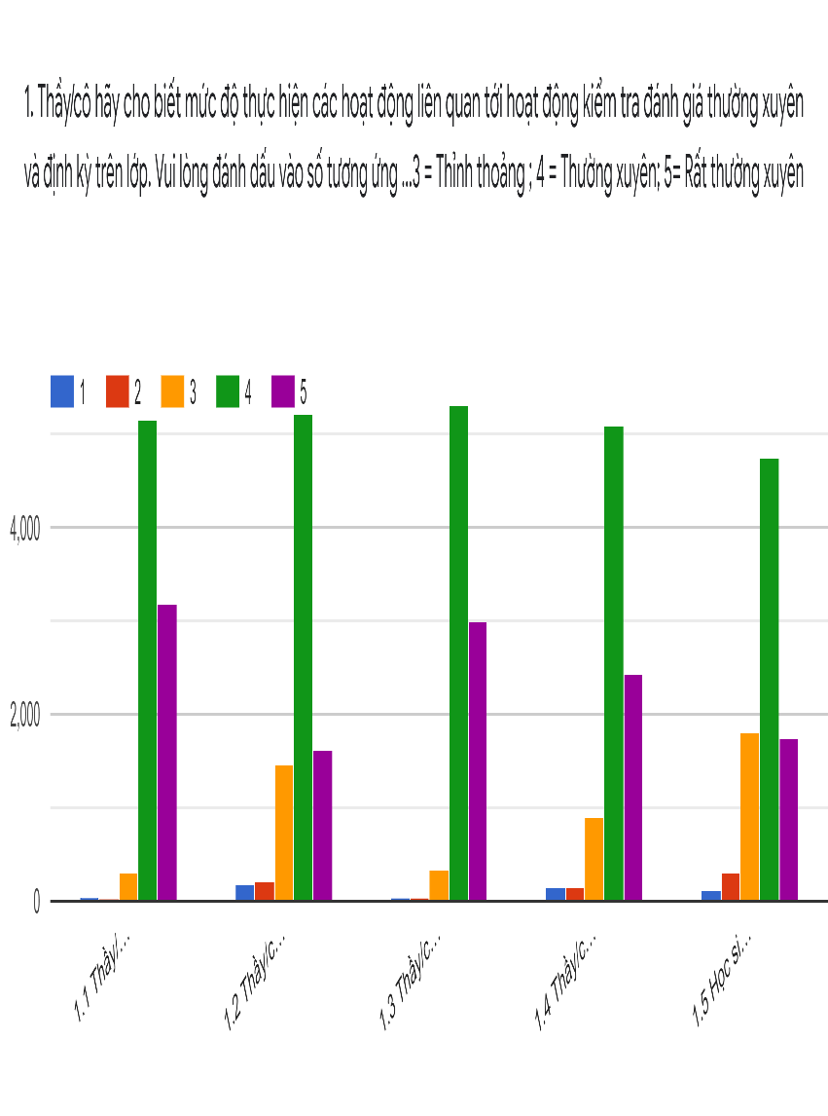
Language Assessment at Schools in Vietnam: Teachers’ Perceptions
Teachers’ Claims on the frequencies of employing testing and assessment
S1. Frequency of applying the assessment process according to the guiding documents.
S2. Frequency of using test banks on assessment activities for classroom formative and summative assessment.
S3. Frequency of conducting formative assessment activities during the teaching process.
S4. Frequency of combining feedback giving and assessment by scores in foreign language assessment.
S5. Frequency of organizing students’ self-assessment and peer assessment
S1
S2
S3
S4
S5
Notes:
The survey results show that the documents on the process of organizing regular and periodic assessment for all levels have been applied by the majority of teachers. Teachers frequently use guidelines for assessing foreign language competence, using different assessment measures, assessment by comments and grades. During the assessment process, students are involved in self-assessment and peer assessment in the learning process. Most teachers regularly apply the assessment process according to the guiding documents in which 59.2% of high school teachers use it regularly and 36.6% very often (Mean = 4.31); 74.4 % of teachers regularly use test banks when conducting assessment for formative and summative assessment activities in class. Assessment activities are used frequently in the teaching process (95.2% of teachers say that they use them regularly and very often, Mean = 4.28). The activities of assessment by giving feedback and by scores in the assessment of foreign languages are given more attention (86.2% at a regular and very frequent level, Mean = 4.09). The majority of students began to be involved in the process of self-review as well as peer-review in the class (74.3% at a regular and very frequent level, Mean = 3.88).

Slide 14
Language Assessment at Schools in Vietnam: Teachers’ Perceptions
Administrators’ Claims on the frequencies of employing testing and assessment
90.5% of administrators said that the locality had organized training on building test banks for formative and summative assessment
89.4% of administrators said that the locality had organized training on how to use test banks for formative and summative assessment
89.4% of administrators said that teachers were asked to use test banks for formative and summative assessment provided

Slide 15
Language Assessment at Schools in Vietnam: Teachers’ Perceptions
Teachers’ Claims on the effectiveness of testing and assessment practices
S1. Guiding documents help teachers implement the process of organizing formative and summative assessment easily. (M=4.12)
S2 Following the guiding document on the process of organizing formative and summative assessment significantly improves the quality of teaching and learning (M=4.06)
S3 Training helps teachers improve their ability to conduct formative and summative assessment (M=4.10)
S4 Training helps teachers improve their ability in testing and assessment following international standards of practices (M=3.98)
S5 Formative and summative assessment accurately reflect students’ language competence (M=4.02)
S6 Teachers use formative and summative assessment results effectively (M=4.12)
S7 Teachers find that the test bank on assessment activities helps them effectively organize formative and summative assessment activities. (M=3.91)
Notes:
Most of the teachers and administrators who participated in the responses gave a positive assessment of the effectiveness of the assessment activities at the school. The average Mean index for the contents of the effectiveness of regular and periodic assessment activities at high schools is 4.04. In which, teachers rated the most effective level of instructional documents. The guiding documents make it easier for localities to implement regular assessment for foreign language subjects (Mean= 4.12). Teachers believe that teacher training and training contents to help teachers improve their capacity for regular and periodic assessment in the teaching process are highly effective activities (89.9%, Mean = 4.10 ). Teachers and administrators also commented that the guiding documents on the process significantly improved the quality of teaching and learning (Mean = 4.06 – Teacher and Mean = 4.10 - Management staff). 92.2% of teachers are confident that they use the results of regular and periodic assessment effectively/very effectively. However, the number of teachers who are still confused and find that regular and periodic assessment activities do not really reflect relatively accurately the students' ability still accounted for 13.7% (mean=4.02). However, the effectiveness of the training contents that help teachers improve their ability in testing and assessment in the direction of international standard approaches and the use of data banks in testing and assessment was found by teachers with lower scores. compared with other contents (Mean = 3.98 and 3.91) (Table 2.3). Some teachers suggested expanding the question bank and the test data bank. The data bank on testing and evaluation is not really rich, nor does it meet the diversity and difference by region. In particular, many teachers said that it was difficult to find materials for the listening test. Therefore, it is necessary to provide test/exam question bank data, especially the listening part, to help teachers make the listening test more convenient and easier.

Slide 16
Language Assessment at Schools in Vietnam: Teachers’ Perceptions
Teachers’ Claims on the effectiveness of testing and assessment practices
Some teachers suggested expanding the question bank and the test bank.
The data bank on testing language competency is not really rich, nor does it meet the diversity and difference by region. In particular, many teachers said that it was difficult to find materials for the listening test. Therefore, it is necessary to provide test/exam question bank data, especially the listening part, to help teachers make the listening test more convenient and easier.
Notes:
Most of the teachers and administrators who participated in the responses gave a positive assessment of the effectiveness of the assessment activities at the school. The average Mean index for the contents of the effectiveness of regular and periodic assessment activities at high schools is 4.04. In which, teachers rated the most effective level of instructional documents. The guiding documents make it easier for localities to implement regular assessment for foreign language subjects (Mean= 4.12). Teachers believe that teacher training and training contents to help teachers improve their capacity for regular and periodic assessment in the teaching process are highly effective activities (89.9%, Mean = 4.10 ). Teachers and administrators also commented that the guiding documents on the process significantly improved the quality of teaching and learning (Mean = 4.06 – Teacher and Mean = 4.10 - Management staff). 92.2% of teachers are confident that they use the results of regular and periodic assessment effectively/very effectively. However, the number of teachers who are still confused and find that regular and periodic assessment activities do not really reflect relatively accurately the students' ability still accounted for 13.7% (mean=4.02). However, the effectiveness of the training contents that help teachers improve their ability in testing and assessment in the direction of international standard approaches and the use of data banks in testing and assessment was found by teachers with lower scores. compared with other contents (Mean = 3.98 and 3.91) (Table 2.3). Some teachers suggested expanding the question bank and the test data bank. The data bank on testing and evaluation is not really rich, nor does it meet the diversity and difference by region. In particular, many teachers said that it was difficult to find materials for the listening test. Therefore, it is necessary to provide test/exam question bank data, especially the listening part, to help teachers make the listening test more convenient and easier.

Slide 17
Language Assessment at Schools in Vietnam: Teachers’ Perceptions
Teachers’ Claims on the challenges in testing and assessment practices
S1 Guidelines for implementing formative and summative assessment are not comprehensive and clear (M=2.61)
S2 Formative assessment is difficult to implement in local teaching conditions (M=2.73)
S3 Summative assessment is difficult to implement in local teaching conditions (M=2.68)
S4 Guidance on how to synthesize and record results of assessment is difficult to implement in local teaching conditions (M=2.61)
S5 Teachers are not familiar with the systematic storage of plans, evidence of the results of learning (M=2.69)
S6 Teachers are unfamiliar with the use of formative and summative assessment results to adjust the teaching and learning process (M=2.52)
Notes:
In the process of implementing the regular and periodic assessment process, teachers also encountered some difficulties: 25.4% of teachers said that the guidelines for implementing assessment and assessment in some places are still incomplete and clear. In particular, teachers want, in addition to the instruction text, to have more illustrative examples and detailed training to be able to practice and implement more easily. In some localities, the time for periodic assessment and examination and the time for reporting results to upper management is too close together, causing difficulties for teachers in the implementation process. When implemented, some methods in regular assessment are still difficult to implement in local teaching conditions (30.3% agree/strongly agree), and in periodic assessment 29.1 %. For example, some teachers think that due to the large number of students in the area, regular assessment through verbal comments, recording comments in notebooks is very time-consuming, so it may affect the time of the class. teach. Only more than half of teachers said that they had no difficulty implementing regular and periodic assessment methods in their local teaching conditions (53.1% and 55.8%). Similarly, nearly 30% of teachers said that they have difficulty when they are not used to systematically storing plans and evidence of the results of regular and periodic assessment of students. 24.1% of teachers who responded to the survey said that they are not familiar with the use of assessment results to adjust the teaching and learning process. Table 2.7 shows that a standard deviation index higher than 1 (with Mean between 2.52 and 2.73) indicates that there may be a larger variation in the data set. The level of difficulty therefore needs to be further analyzed by region and school level to find this difference.

Slide 18
Language Assessment at Schools in Vietnam: Teachers’ Perceptions
Teachers’ Claims on the challenges in testing and assessment practices
Teachers want, in addition to the instruction text, to have more illustrative examples and detailed training to be able to practice and implement more easily.
Some teachers think that due to the large number of students in their areas, regular assessment through verbal comments, written feedback in notebooks is very time-consuming, so it may affect the time of the class.
Notes:
In the process of implementing the regular and periodic assessment process, teachers also encountered some difficulties: 25.4% of teachers said that the guidelines for implementing assessment and assessment in some places are still incomplete and clear. In particular, teachers want, in addition to the instruction text, to have more illustrative examples and detailed training to be able to practice and implement more easily. In some localities, the time for periodic assessment and examination and the time for reporting results to upper management is too close together, causing difficulties for teachers in the implementation process. When implemented, some methods in formative assessment are still difficult to implement in local teaching conditions (30.3% agree/strongly agree), and in summative assessment 29.1 For example, some teachers think that due to the large number of students in the area, regular assessment through verbal comments, recording comments in notebooks is very time-consuming, so it may affect the time of the class. teach. Only more than half of teachers said that they had no difficulty implementing regular and periodic assessment methods in their local teaching conditions (53.1% and 55.8%). Similarly, nearly 30% of teachers said that they have difficulty when they are not used to systematically storing plans and evidence of the results of regular and periodic assessment of students. 24.1% of teachers who responded to the survey said that they are not familiar with the use of assessment results to adjust the teaching and learning process. The finding shows that a standard deviation index higher than 1 (with Mean between 2.52 and 2.73) indicates that there may be a larger variation in the data set. The level of difficulty therefore needs to be further analyzed by region and school level to find this difference.

Slide 19
Language Assessment at Schools in Vietnam: Teachers’ Perceptions
Teachers’ Suggestions for better support in testing and assessment practices
S1 Providing more helpful guidelines on formative and summative assessment (M=4.13)
S2 Providing more professional training on applying formative and summative assessment methods that fit local teaching conditions (M=3.98)
S3 Providing more professional training on synthesizing, storing and using learning results and learning evidence based on formative and summative assessment (M=3.90)
S4 Building a test bank on formative and summative for each school (M=4.13)
S5 Guiding for extensive implementation of test banks on formative and summative assessment activities in foreign language teaching and learning (M=4.11)
Notes:
When asked about suggestions for upcoming activities related to assessment, most of the teachers and administrators said that the proposed contents are necessary and necessary. The average Mean is 4.15, showing that teachers and administrators agree with the following five groups of solutions: S1 Providing more helpful guidelines on formative and summative assessment (M=4.13)
S2 Providing more professional training on applying formative and summative assessment methods that fit local teaching conditions (M=3.98)
S3 Providing more professional training on synthesizing, storing and using learning results and learning evidence based on formative and summative assessment (M=3.90)
S4 Building a test bank on formative and summative for each school (M=4.13)
S5 Guiding for extensive implementation of test banks on formative and summative assessment activities in foreign language teaching and learning (M=4.11).
89.6% of teachers surveyed said that in the coming period, they need to be supplemented with guidance documents for regular and periodic assessment on assessment methods; 93.5% of teachers feel that training activities on guiding the implementation of assessment methods need to be linked to actual local conditions; 89.2% of teachers said that it is necessary/necessary to build a data bank on regular and periodic assessment activities in the locality, especially the content of listening and assessment skills. should be implemented at multiple levels (Mean = 4.13 (GVPT); 4.22 (CBQL)). Guidance on effective implementation and use of data banks should also be carried out in the coming period (87.2%, Mean = 4.11 (GVPT) and Mean = 4.24 (CBQL)).

Slide 20
Language Assessment at Schools in Vietnam: Teachers’ Perceptions
Teachers’ Suggestions for better support in testing and assessment practices
The construction of a data bank for formative and summative assessment should be built by school or group of schools in each district and each province so that it can be supplemented and adjusted to suit the specific context of students and localities.
Teachers wish to be provided with the summative test question banks to have a better orientation for students to review.
Some teachers also wish to have a website about shared formative and summative assessment activities where teachers can exchange ideas and resources with colleagues.
At the same time, some teachers also want to be trained in the use of information technology-assisted assessment methods to reduce the time for teachers to mark papers.
In terms of training, teachers want to be sent out alternately. This is to avoid the case that some teachers have been trained many times, while others have not had the opportunity to participate. More guidance is needed so that trained teachers will provide detailed re-training to other local teachers to be able to implement the guidelines or training content effectively.
Notes:
Teachers’ Suggestions for better support in testing and assessment practices
The construction of a data bank for formative and summative assessment should be built by school or group of schools in each district and each province so that it can be supplemented and adjusted to suit the specific context of students and localities. The data for the periodic test in the question bank needs to be more feasible and especially suitable for students in each area.
Teachers wish to be provided with the summative test question banks to have a better orientation for students to review.
Some teachers also wish to have a website about shared formative and summative assessment activities where teachers can exchange ideas and resources with colleagues.
At the same time, some teachers also want to be trained in the use of information technology-assisted assessment methods to reduce the time for teachers to mark papers.
In terms of training, teachers want to be sent out alternately. This is to avoid the case that some teachers have been trained many times, while others have not had the opportunity to participate. More guidance is needed so that trained teachers will provide detailed re-training to other local teachers to be able to implement the guidelines or training content effectively.

Slide 21
Language Assessment at Schools in Vietnam: Teachers’ Perceptions
Some additional comments (1)
The innovation of testing and assessing students in the direction of fully assessing the 4 skills of Listening, Speaking, Reading and Writing still faces many difficulties, especially influenced by the content and form of the high school graduation examination.

Slide 22
Language Assessment at Schools in Vietnam: Teachers’ Perceptions
Some additional comments (2)
More detailed guiding documents in the assessment of final year students are needed.
The sources of question banks for assessing final year students following the test specifications should be diversified.
Better IT infrastructures for assessing students are needed.
Notes:
According to the teacher, the question bank is mainly designed by the teacher herself or shared from friends and colleagues inside and outside the province. The bank of topics and questions supported by ministries and departments is not much. At the same time, it is necessary to supplement the means of assessing foreign language ability for students, especially with the support of information technology.

Slide 23
Language Assessment at Schools in Vietnam: Limitations
The efforts of localities and schools in assessing students’ learning still have certain limitations, not completely meeting the requirements of innovation in testing and assessment.
Assessment work is still heavily influenced by exam pressure that is still relying heavily on teachers, students' parents and students themselves. Study and exam are not compatible with each other.
The pilot English program focuses on training communication skills through the four skills of listening, speaking, reading and writing, but the content of the National high school graduation exam only focuses on reading skills and knowledge of vocabulary and grammar.

Slide 24
Language Assessment at Schools in Vietnam: Limitations
The implementation of formative and summative assessment and building test banks are still limited in localities. The number of banks for assessment is still small. The number of questions according to the test specifications to evaluate the completion of the student's level does not meet the needs of the teachers.

Slide 25
Language Assessment at Schools in Vietnam: Some recommendations
Support provinces in setting up testing centers and quality accreditation centers to support the quality of foreign language teaching in the provinces and cities, in the immediate future, supporting the assessment toolkit of foreign languages online or on computers;
Continue to innovate language exam formats and methods that assess the foreign language ability of high school students according to the output standards right in the learning process and when completing the level.
Build an assessment system in foreign language teaching and learning in Vietnam towards international standards.

Slide 26
Language Assessment at Schools in Vietnam: Some recommendations
Build a shared test bank of English proficiency at levels 1, 2 and 3 for school students to serve as a source of data for teachers and students in the locality to refer to.
Develop a test bank on formative and summative assessment that fit the locality, especially the content of listening skills assessment. The construction of such a test bank should be built by school or group of schools, each district, each province so that it can be supplemented and adjusted to suit the general situation of students. The question bank needs to have periodical test questions to have a better orientation for students to study.

Slide 27
Language Assessment at Schools in Vietnam: Some recommendations
Regarding training, it is necessary to develop a reasonable plan so that teachers can participate in training and retraining, avoiding the case that some teachers have been trained many times, while others have not had the opportunity to join. More guidance is needed so that trained teachers will provide detailed re-training to other local teachers to be able to implement the guidelines or training content effectively.
A website for shared assessment practices should be developed so that teachers can exchange professional development with other teachers.
It is necessary to create conditions for English teachers and specialists to access some highly practical professional knowledge such as: the process of performing assessment activities, techniques for building assessment tools such as lessons. tests, presentations, project assignments, academic records; how to determine the difficulty and distinction of exam questions, the difficulty of vocabulary and grammar according to the NFLP.

Slide 28
THANK YOU FOR YOUR ATTENTION

