Slide 1
Developing World Class Industry Partnerships
Dr Rebecca Charles
www.cranfield.ac.uk
© Cranfield University May 2018

Slide 2
About Cranfield University
We are creating leaders in technology and management
We unlock the potential of people and organisations by partnering with business and governments to deliver transformational research, postgraduate education and professional development.
We are an exclusively postgraduate university located at the heart of the UK.
© Cranfield University May 2018

Slide 3
Benefits of working with Cranfield
Expertise,
Flexibility,
Unique, industrial-scale facilities,
Access to funding,
Unbiased, impartial and independent approach.
© Cranfield University May 2018

Slide 4
Distinctive strengths
Our expertise is in our deep understanding of technology and management and how these work together to benefit the world.
Aerospace,
Defence and Security,
Energy and Power,
Environment and Agrifood,
School of Management,
Manufacturing,
Transport Systems,
Water.
© Cranfield University May 2018

Slide 5
A premier learning experience for professionals
15,000
Executives attend our Continued Professional Development (CPD) programmes every year
4,000
Postgraduate students every year
800
Doctoral students every year
• Come from outside the UK (100+ countries)
• Study part-time while in employment
50%
+
© Cranfield University May 2018

Slide 6
Working with Cranfield
Strategic
Shared strategy and route maps
Enabling agreements
Key account management
Joint research programmes
Consultancy
Access to education
Short-term projects
Transactional
© Cranfield University May 2018

Slide 7
Examples of our partnerships and initiatives
FORMAT | EXAMPLE
Embedded individuals | Where companies encourage corporate researchers to work in a specific on-campus lab. Airbus
Create courses to raise profile | Accident investigation course, new Cranfield Masterships™, many professional development courses. Develop courses with industry. Industry advisory boards.
Co-created research centres | Funding is obtained from a combination of research funds and company sponsorship. Cranfield AIRC with Airbus. CAA innovation Sandbox
Focused calls for research proposals | Catalyst research grants. Creation of a specialised Research innovation office which locates and offers advice on certain calls
Student competitions | The Siemens Global University Challenge. The Unilever Ice-cream challenge, Johnson Matthey Agritech Partnership Programme
Collaboration on publicly funded research | Working with other universities to provide added strength, and selected companies
Encouraging innovation from within | Appointed Knowledge Exchange and Enterprise Champions to spread the word surrounding funding opportunities and also to recognise good ideas, Small business and innovation accelerators. ICURe

Slide 8
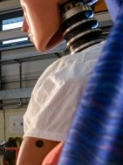
Transformational research
Mechanical, Aeronautical and Manufacturing Engineering
ranked:
Unique facilities include:
Aerospace Integration Research Centre.
Crash Impact Centre.
Access to a Ministry of Defence (MOD) secure site.
National Wind Tunnel Facility.
National Reference Centre for Soils.
Facility for Airborne Atmospheric Measurements.
(QS World University Rankings 2017)

Slide 9
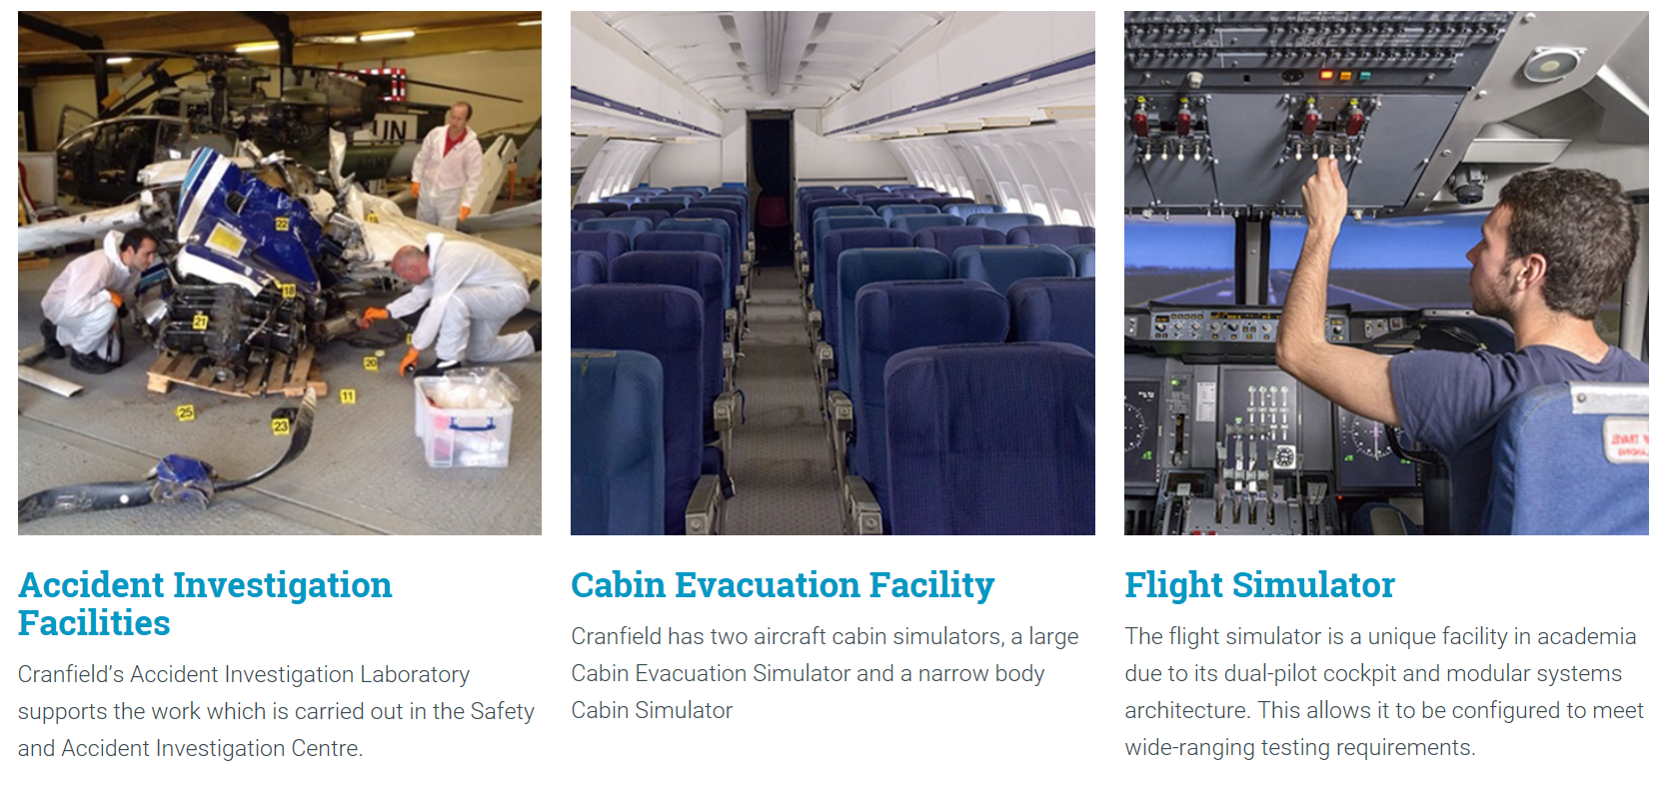
Accident investigation facilities
Use your assets as a catalyst for collaboration…

Slide 10
Cranfield Masterships®
Master’s level apprenticeships
university provider of master’s-level apprenticeships – Systems Engineering Master’s Apprenticeship Programme.
business school to deliver an Executive MBA via the apprenticeship route.
Distance learning, increased technology
© Cranfield University May 2018

Slide 11
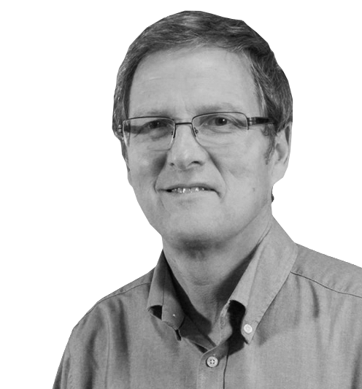
Working with Cranfield
“Cranfield University staff are great people to work with as partners. They are flexible in their approach and, most importantly, they deliver on time and in full.”
Professor Mark Berry Senior Research and Development Manager, Unilever
© Cranfield University May 2018

Slide 12
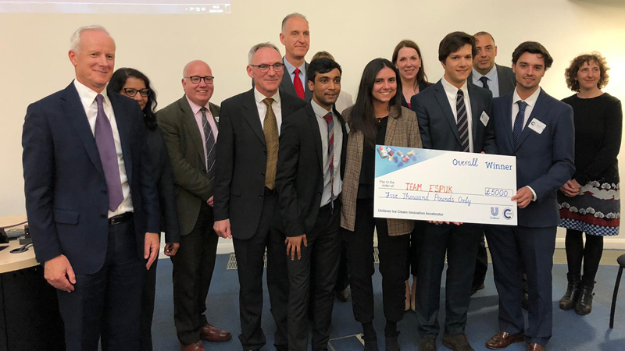
Unilever Ice-cream Innovation Accelerator competition
The eight teams spent four weeks developing their innovative solutions with intensive coaching support from mentors from both Unilever and Cranfield’s Bettany Centre for Entrepreneurship. Each team had seven minutes to pitch their ideas to the judging panel.

Slide 13
Johnson Matthey Agritech Partnership Programme (JMAPP)
Cranfield has been selected as Johnson Matthey's partner of choice
Johnson Matthey looked to fund a small number of intensive innovation support projects. An initial support package (valued in the region of £50k) was available for each of the successful candidates over a period of three months. The participants benefitted from:
Access to our world class technical facilities and expertise
Business know-how and thought leadership from Cranfield School of Management including a programmed series of seminars, masterclasses and investor networking opportunities via the Bettany Centre for Entrepreneurship.
A Johnson Matthey mentor.
Rent-free office space, onsite parking and free WiFi.
Johnson Matthey see the pilot programme as the start of a journey, building a working relationship with this cohort of companies and with a view to taking a longer-term view on the potential for further investment.

Slide 14
Thank you!
https://www.cranfield.ac.uk/press/news-2019/cranfield-students-win-prize-in-unilever-ice-cream-innovation-accelerator-competition
https://www.cranfield.ac.uk/press/news-2019/nbec-joins-new-caa-innovation-sandbox

