Slide 1
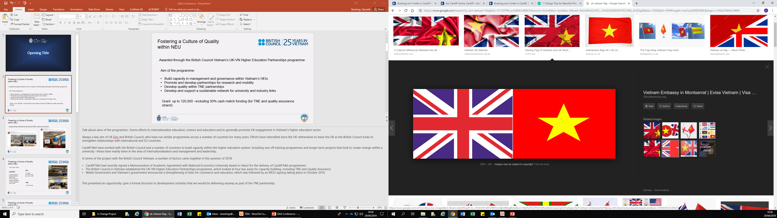

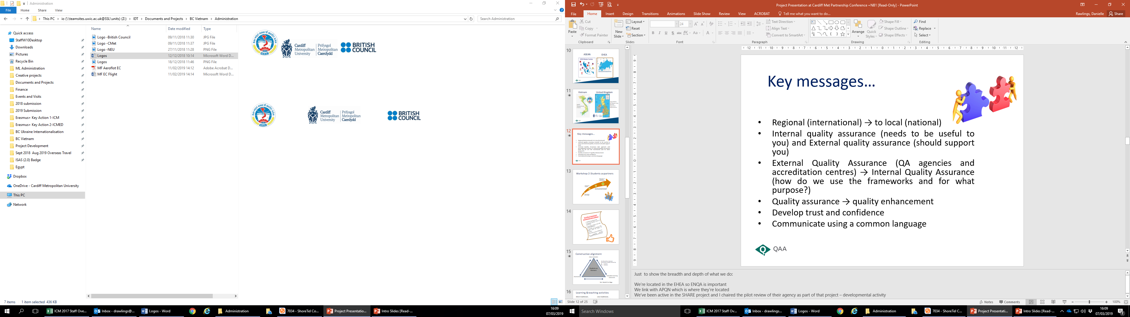

Fostering a culture of quality at National Economics University, Hanoi, Vietnam
Notes:
9.35-10.00

Slide 2




CARDIFF:
Europe’s youngest capital city
Friendly, welcoming and safe environment
Low cost of living
Facilities for students of all religions and faiths
Notes:
Cardiff Bay

Slide 3



Cardiff Metropolitan University
5 academic schools
17,000+ students study at one of the
two campuses in Cardiff
9,000+ students study Cardiff Met programme at one of 15 partner institutions abroad
National Economics University
Public university in Hanoi with approx. 45,000 students
32 schools, faculties and centres
Number of joint programmes – Australia, Belgium, France, the UK and the USA
Notes:
Brief overview of Cardiff Met and NEU provision

Slide 4

About NEU…
“SHARING KNOWLEDGE - NURTURING THE FUTURE”
Founded in 1956, the National Economics University is one of the leading universities in Economics, Public Management and Business Administration in Vietnam.
45.000 students in bachelor, master and doctoral levels;
19 Faculties, 16 Schools, Institutes and Centers;
31 undergraduate majors (54 specializations), 15 Master Majors (34 specializations) and 14 doctorate majors (25 specializations) in Vietnamese
Hundreds of Nation-level and Ministry-level research projects;
NEU is now chairing a network of more than 40 universities in VN in economics and business administration.
Over 1200 staff members:
150 Professors and Associate Professors
290 Ph.Ds

Slide 5

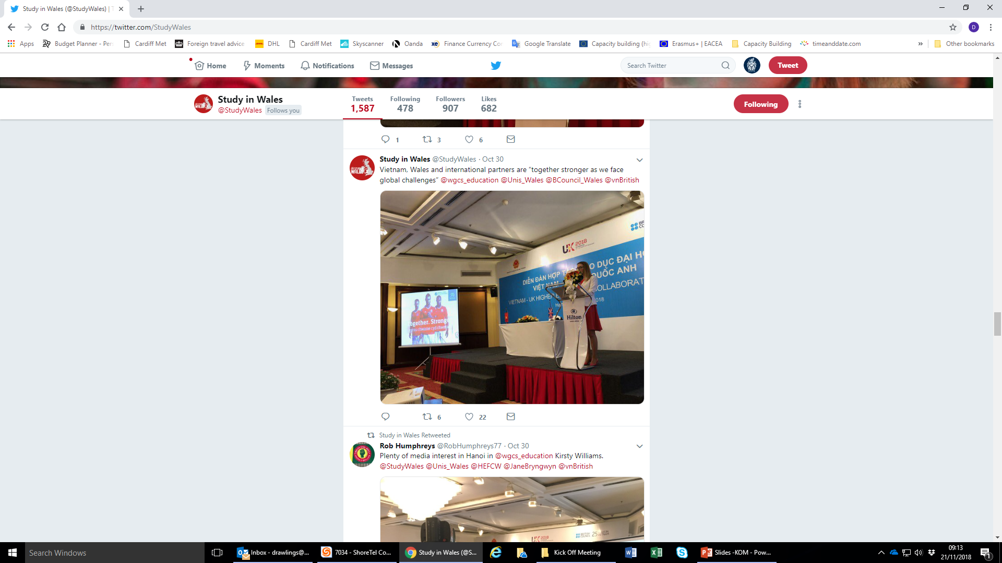

Establishing the partnership
Supporting institutional priorities AND national priorities:
Notes:
A number of factors came together in the summer of 2018:
Cardiff Met had recently signed a Memorandum of Academic Agreement with National Economics University based in Hanoi for the delivery of Cardiff Met programmes
The British Council in Vietnam established the UK-VN Higher Education Partnerships programme, which looked at four key areas for capacity building, including TNE and Quality Assurance
Welsh Government and Vietnam’s government announced a strengthening of links for commerce and education, which was followed by an MOU signing taking place in October 2018.
When reporting internally on how the fund (and significant cash contribution) supports strategic priorities, it ticked all the boxes. Particularly as a university with a strong sense of its global responsibility and a desire to contribute to the development of higher education development around the world.

Slide 6

Fostering a culture of quality at NEU
Awarded through the British Council Vietnam’s UK-VN Higher Education Partnerships programme
Aim of the programme:
Build capacity in management and governance within Vietnam’s HEIs
Promote and develop partnerships for research and mobility
Develop quality within TNE partnerships
Develop and support a sustainable network for university and industry links
Grant Award: £120,000*
*including 50% cash match funding (for TNE and quality assurance strand)
Notes:
Talk about aims of the programme : forms efforts to internationalise education, science and education and to generally promote UK engagement in Vietnam’s higher education sector
Always a key aim of UK Gov and British Council, who have run similar programmes across a number of countries for many years. Efforts have intensified since the UK referendum to leave the UK as the British Council looks to strengthen relationships with international and EU countries.
Cardiff Met have worked with the British Council and a number of countries to build capacity within the higher education system. Including one off training programmes and longer term projects that look to create change within a university –these have mainly been in the area of internationalisation and management and leadership.
In terms of the programme launched by the British Council in Vietnam, Cardiff Met had recently signed a Memorandum of Academic Agreement with National Economics University based in Hanoi for the delivery of Cardiff Met programmes. This presented an opportunity to give a formal structure to development activities that we would be delivering anyway as part of the TNE partnership, and to disseminate the topic of the project across Vietnam to support other universities in their quality journey.

Slide 7
Project timeline
11/18
02/19
03/19
09/19
12/19
Desk study / survey
Delivery of programme to NEU
Cardiff Met partner conference and implementation of change projects
NEU Change Projects Disseminated with Cardiff Met, Vietnam
Present results to MOET; Report to British Council; Student Engagement NEU

Slide 8
Staff survey on QA, main findings: n=50
1
48 staff at NEU described QA experience as good / adequate
2
Over half respondents indicated no formal training in QA
3
49 staff would like further / more training on QA
4
Specific areas of interest in further training: student engagement; course design and review; assessment design and review
5
Assessment relied on: exam, essay, presentation, group project, case study
Teaching relied on: power point, discussion, case study

Slide 9
Staff survey – Which of the skills do you think your students will need as a graduate of your programme?
Notes:
- Characteristics indiscriminative of type of research performed.
- VIC comparison of biomedical vs social science application.
- Case studies on ‘guilty knowledge’, ‘deception’, ‘public/private knowledge’, ‘danger’.

Slide 10
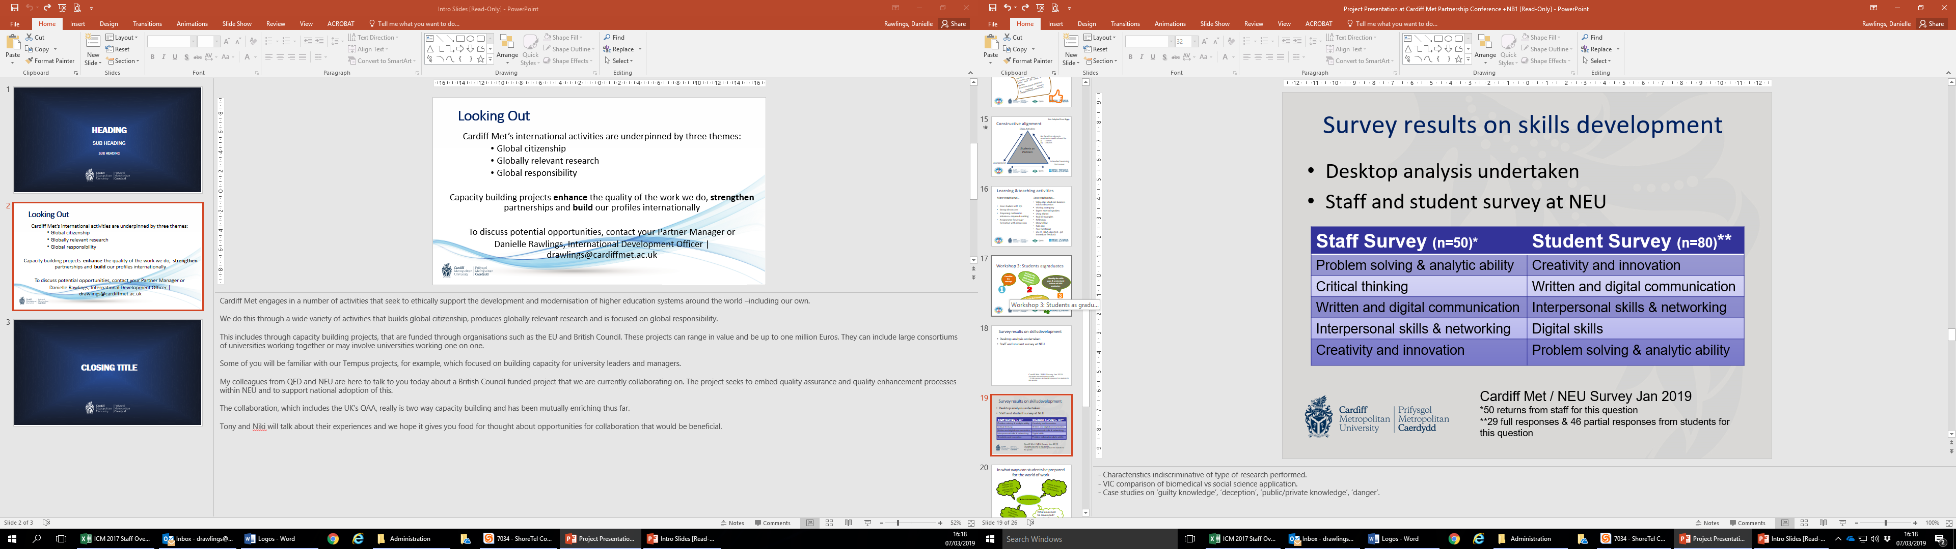
Survey results on skills development
Cardiff Met / NEU Survey Jan 2019
*50 returns from staff for this question
**29 full responses & 46 partial responses from students for this question
Notes:
- Characteristics indiscriminative of type of research performed.
- VIC comparison of biomedical vs social science application.
- Case studies on ‘guilty knowledge’, ‘deception’, ‘public/private knowledge’, ‘danger’.

Slide 11
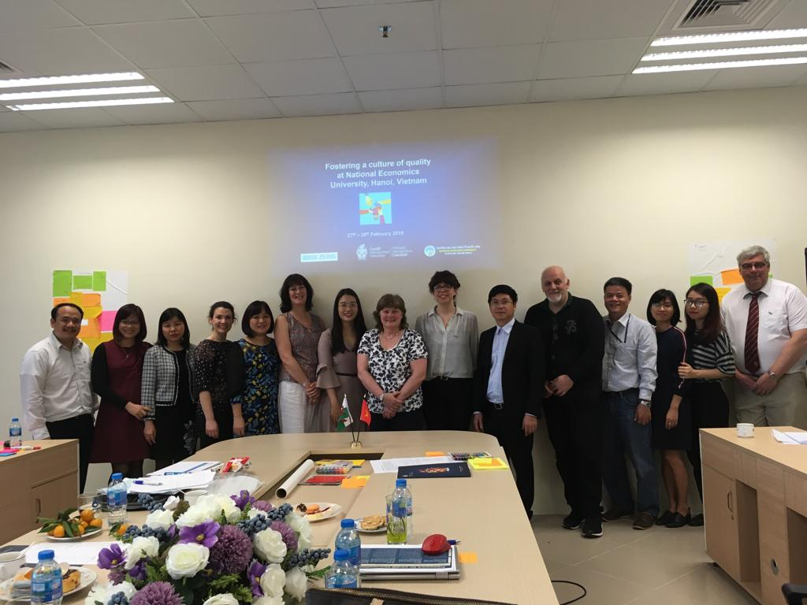
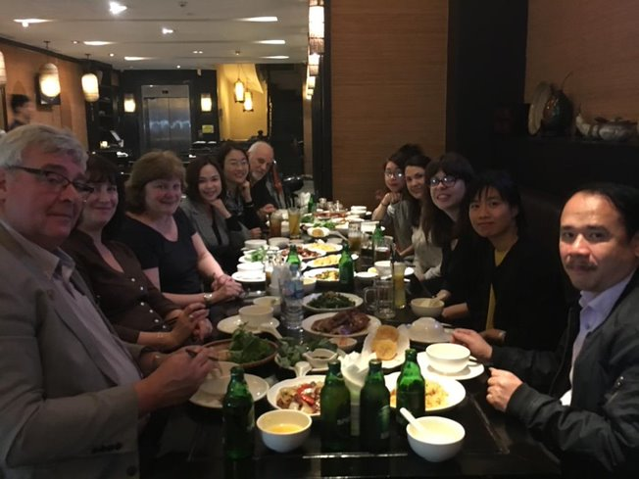
Cardiff Met visit NEU 27th – 28th Feb 2019
Three Workshops:
QA – the big picture
Students as partners
Students as graduates
Notes:
Real “team” mentality fostered – excellent hosts!

Slide 12
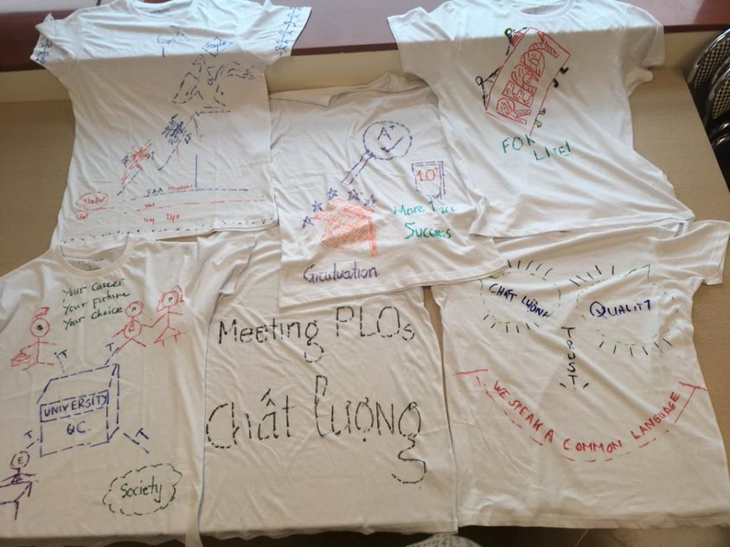
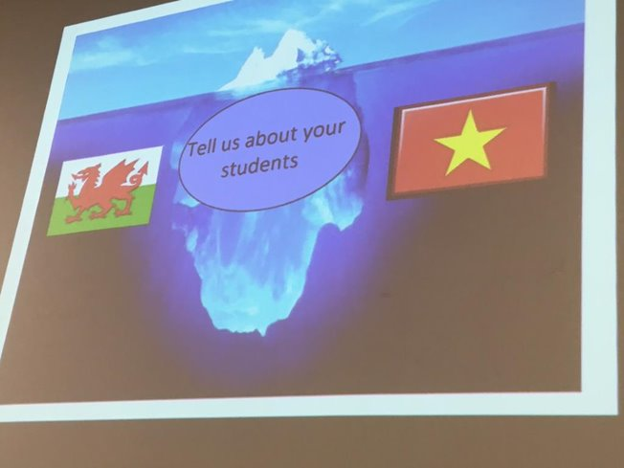
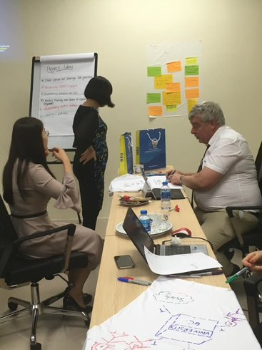
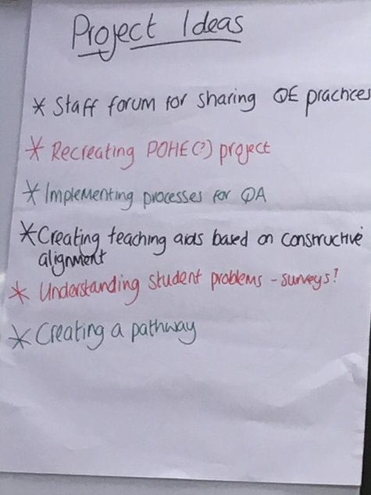
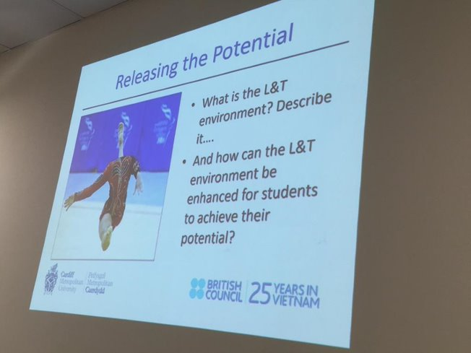
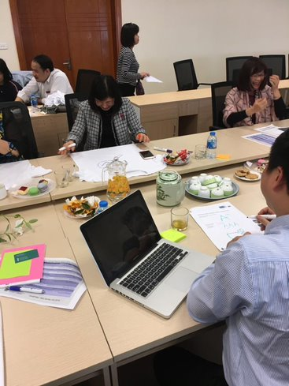
Developing the Partnership….
Notes:
These photos are useful to give a flavour of the interaction over the 2 days
Ideas board updated throughout – project ideas noted as we went through
Workshop materials made available to NEU as a resource after the training
NEU very engaged and happy to participate
Additional members joined throughout – a real “buzz” around the training

Slide 13
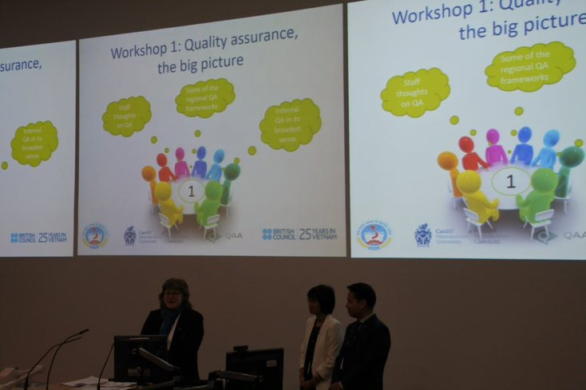
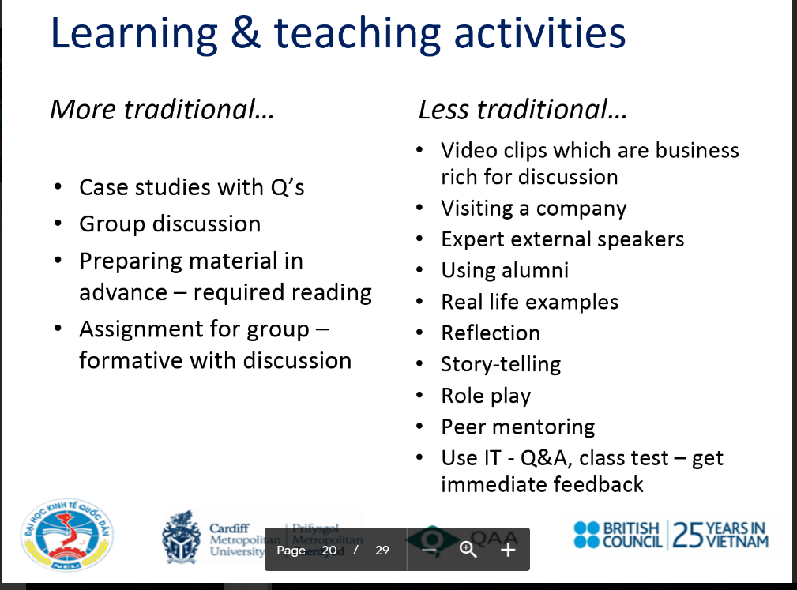

NEU visit Cardiff Met 7th – 8th March 2019
Cardiff Met Partner Conference
Notes:
3 members of the NEU Training Group travelled to Cardiff the following week –building on the momentum from the training
NEU delivered an excellent presentation in collaboration with Dr Niki Bolton and created much of the content themselves (great slides as shown) demonstrating they had taken on board the concepts explored during the training
Despite initial apprehension around the presentation, the team presented confidently and demonstrated their engagement with the ideas presented, evidencing the capacity-building taking place

Slide 14


NEU Implementing the change projects
Decision by NEU project team to focus on:
Establishing a Community of Practice
Developing Student Engagement
Consider QA and QE aspects
Involve students
Notes:
Still in development stage
Ideas harnessed after the training visit and following further consultation with the NEU training participants but based on the cycle of QA-QE
Cardiff Met are supporting NEU in the development of the projects and the programme of wider implementation within NEU and among other HE providers in Vietnam but NEU colleagues very much driving the projects they want to deliver.
Focusing on Community of Practice – specifically around Learning and Teaching aids:
Big classes of students (60 - 70 students), it is hard to motivate and communicate to different groups of students at the same time.
What kind of activities should be taken in teaching in order to develop a full set of skills for students
Some instructive policies (as teaching aids) for lecturers
Some questions for consideration now being ironed out around the coordination, membership and activities and timeframes for the community of practice.
This work will feed into the wider design and implementation of an institutional Student engagement policy
Student engagement policy – essential process for NEU’s quality manager, institutional drive
+ Defining and understanding the full concept of student engagement
+ Reviewing and evaluating NEU policy system for SE
+ Carrying the survey for students and staffs and analyzing data
+ Recommending or building up SE policy system for NEU

Slide 15
Specific benefits of the project
Opportunity to foster QA and QE opportunities
A framework for continued delivery and sustainability
Capacity building for both Cardiff Met and NEU involved in TNE
Culture of quality and enhancement NEU "ambassadors"
Potential for wider institutional and national roll out
Genuine collaborative effort – excellent "project team"
Notes:
Structured long-term training provides a framework for continued delivery and sustainability
Having the Quality Department as part of the project team is a great bonus and shows clear buy-in from NEU who can see the merit of working directly "on the ground" within the schools and its academic staff.
Cardiff Met staff who are not involved with the project are clearly interested and want to know more – real enthusiasm

Slide 16


Xin Cảm Ơn
Conclusions – mutual capacity building
Profile
Global Wales/ Vietnam
People
Global responsibility
Projects
Global networks

