Slide 1
Overview of QAA’s work in the UK and overseas and the UK Quality Code
Fiona Crozier, former Head of International, QAA
24th September 2019
Notes:
This presentation template includes examples of the slides available. Select Master slides, as appropriate, to create a presentation best suited to your content and requirements. Notes are included for guidance and these should be removed before finalising. Additional guidelines are available on Qmmunity, in the QAA Brand site, along with approved images. http://qmmunity.qaa.ac.uk/agency-resources/brand/Pages/Welcome.aspx
Title slide: A title slide must be used in all presentations.
It includes the presentation title in grey text at 40pt, and the presenter’s name and job title in 32pt.
The event title and date are both 32pt, in a colour taken from the colour palette.
Colours: This presentation template contains a pre-set colour palette which should be used consistently throughout the presentation.

Slide 2
Introduction
Aims of the presentation:
To set the context for external QA in the UK
To introduce the key UK reference point for external QA: the UK Quality Code
To illustrate some parallels between the UK and Vietnam

Slide 3
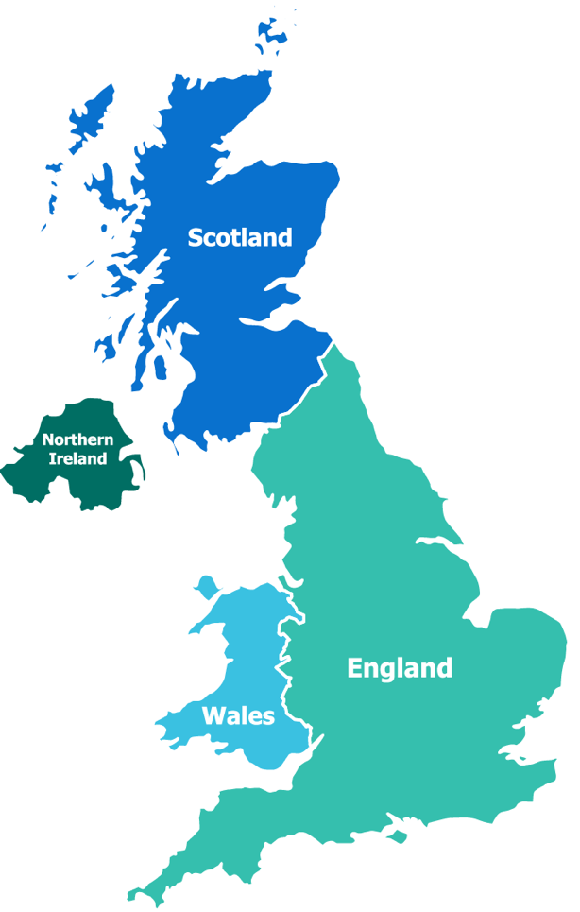
Notes:
‘Understanding the requirements of quality assessment’ – understanding has to be nation specific
Devolved administrations for NI, Scotland, Wales - responsible for many domestic policy issues, including education
QAA operates UK-wide and takes account of the differing requirements from the devolved nations
Until recently, main focus of external quality assurance activity has been cyclical review by QAA
HER (and its derivatives) applied to England, NI and Wales – to all types of provider, including APs
Enhancement Led Institutional Review (ELIR) applied in Scotland.
Over last few years, significant policy developments have signalled a shift in the approach to quality assessment

Slide 4
Our mission is to safeguard standards and improve the quality of UK higher education, wherever it is delivered around the world
Notes:
QAA is the independent body entrusted with monitoring and advising on standards and quality in UK higher education
Our mission is to safeguard standards and improve the quality of UK higher education, wherever it is delivered around the world
We act in the public interest for the benefit of students and support higher education providers in providing the best possible student learning experience
We are dedicated to checking that the three million students working towards a UK qualification get the higher education experiences they are entitled to expect

Slide 5
Characteristics of the UK higher education sector
Mass levels of participation, with high student retention
A world-leading research base
Diverse range of providers
Recognised worldwide for high quality and standards
Notes:
Some of the characteristics of the UK higher education sector:
Mass levels of participation, with high student retention
A world-leading research base
Diverse range of providers
Recognised worldwide for high quality and standards
AUTONOMOUS

Slide 6
Higher education students in the UK (2017-18)
2.34 million students (approx), of which:
1.77 million undergraduates
570,000 postgraduates
Where did they study (approx)?
England (1.90 million)
Scotland (245,000)
Wales (134,000)
Northern Ireland (55,000)
Where were they from (approx)?
UK (1.88 million)
European Union (140,000)
Outside the European Union (320,000)
Notes:
Approximately 2.32 million HE students studied in the UK in 2016-17:
1.77 million undergraduates
552,000 postgraduates
Where did they study?
Most studied in England (1.89 million)
Scotland (242,000)
Wales (129,000)
Northern Ireland (54,000)
Where were they from?
UK (1.88 million)
EU (135,000)
Outside the EU (308,000)

Slide 7
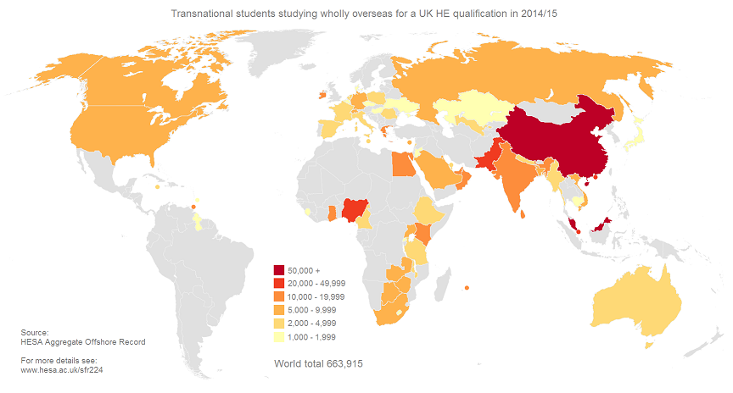
Over 80% of UK universities are involved in some form of TNE, delivered all over the world

Slide 8
Snapshot of UK transnational education (2016-17)
709,323 TNE students:
77,388 studying within the European Union (EU)
631,935 outside the EU
NB: in 2017-18 total numbers were 690,000
Top 10 countries for UK TNE (2015-16, student numbers)
Malaysia (74,180)
China (70,240)
Singapore (48,290)
Pakistan (43,870)
v) Nigeria (32,925)
vi) Hong Kong (27,390)
Sri Lanka (24,480)
viii) Egypt (21,695)
Oman (21,250)
x) UAE (17,750)
Source of data: HESA (2016-17)

Slide 9
Franchised programmes
Validated programmes
Joint, dual/double or multiple awards granted by one or more other awarding bodies.
Articulation arrangements
Study abroad, including exchanges and student mobility programmes such as ERASMUS.
Provision of learning support, resources or specialist facilities. Branch campuses, educational villages and 'flying faculty’
Distance learning and MOOCs)
Types of TNE partnerships
Notes:
Validated programmes delivered by delivery organisations. Joint, dual/double or multiple awards granted by one or more other awarding bodies. Articulation arrangements, whereby all students who satisfy academic criteria on one programme are automatically entitled on academic grounds to be admitted with advanced standing to a subsequent stage of a programme of a degree-awarding body.7 A range of work-based learning that may involve delivering full programmes, individual modules or elements of programmes for a specific employer, or otherwise using the workplace as a site of learning.8 Credit-rating of learning/training/continuing professional development provided by employers/other organisations.
Provision of learning support, resources or specialist facilities. Branch campuses, educational villages and 'flying faculty' arrangements, which include aspects of collaboration (such as provision of resources or employment of local administrative/clerical staff through arrangements with another organisation). Distance learning and online delivery/massive open online courses (MOOCs) involving work with delivery organisations or support providers.
Branch campuses, educational villages and 'flying faculty' arrangements, which include aspects of collaboration (such as provision of resources or employment of local administrative/clerical staff through arrangements with another organisation).

Slide 10
Our mission is to safeguard standards and improve the quality of UK higher education, wherever it is delivered around the world
Notes:
QAA is the independent body entrusted with monitoring and advising on standards and quality in UK higher education
Our mission is to safeguard standards and improve the quality of UK higher education, wherever it is delivered around the world
We act in the public interest for the benefit of students and support higher education providers in providing the best possible student learning experience
We are dedicated to checking that the three million students working towards a UK qualification get the higher education experiences they are entitled to expect

Slide 11
The UK Quality Code

Slide 12
What is the UK Quality Code for Higher Education?
The UK reference point for Quality and Standards in Higher Education
It offers a benchmark for process and practice for new providers
Enables providers to understand what is expected of them and what they can expect of each other

Slide 13
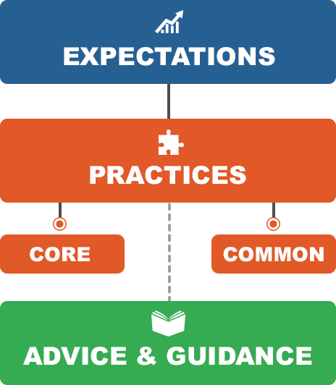
https://www.qaa.ac.uk/quality-code

Slide 14
Structure of advice and guidance
Introduction & explicit links to core and common practices
Guiding principles
Overarching Information
Practical advice and guidance on delivery of theme aims include enhancements and good practice (in particular through reflective questions)
Practical Advice & Guidance
Resources, Further Information, Relevant Organisations & Glossary
Signposting

Slide 16
Some parallels between Vietnam
and the UK

Slide 17
National Economics University
Cardiff Metropolitan University
UK Quality Code/baseline regulatory requirements
MOET standards and criteria

Slide 18
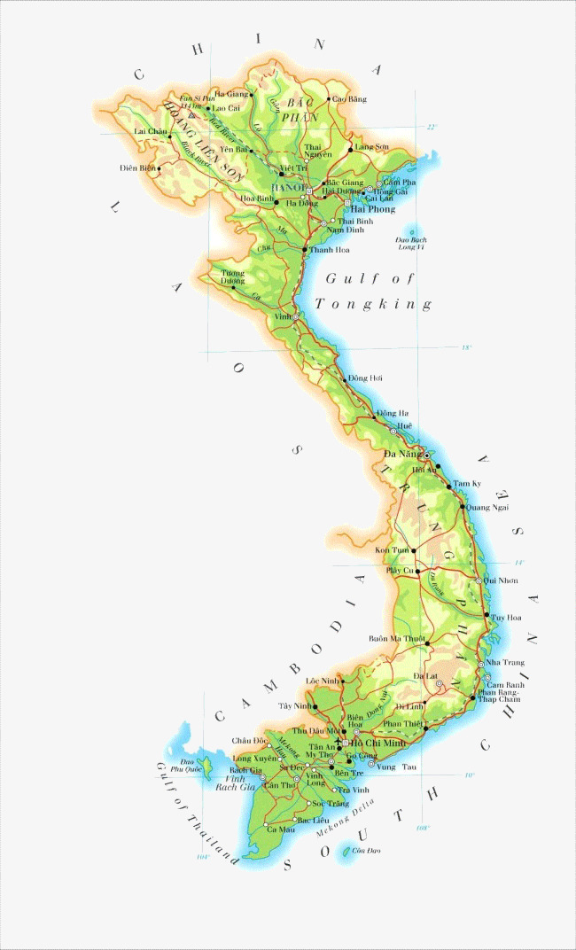
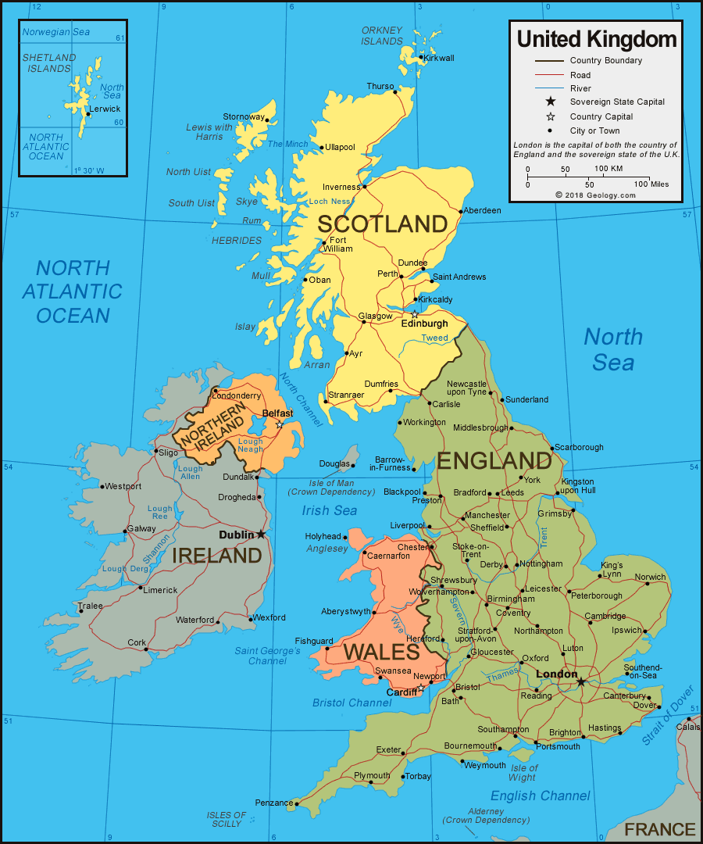
UK
Vietnam
MOET/CEAs
QAA/HEFCW
Notes:
Provider pays model
ESG for reviews insists that all reviews:
Assess internal quality assurance (2.1)
Use methodologies that are fit for purpose with clear aims and objectives, with stakeholders involved in its design (2.2)
Review processes are pre-defined and applied consistently involving a self assessment, external scrutiny and follow-up (2.3)
Uses peer review experts that include a student member (2.4)
Outcomes or judgements are based on explicit and published criteria that are consistently applied (2.5)
There are clear, accessible published reports (2.6)
There are complaints and appeals processes for these reviews (2.7)

Slide 19
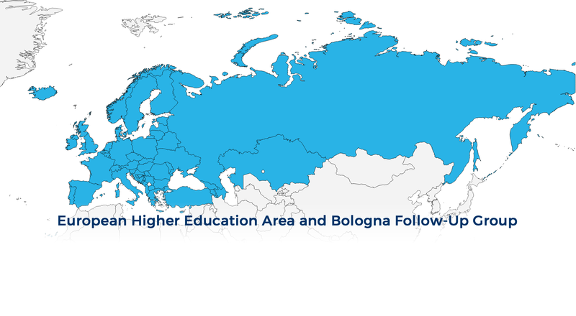
EHEA
ASEAN
AQAF
ESG

Slide 20
To sum up…
We’ve had a look at UK HE and the context within which it sits – questions/discussions around Vietnamese HE and your context: how to they compare and where are the opportunities and challenges for TNE between the two countries?
We looked at some of the existing parallels between the two countries, both regionally and locally that might help
We were introduced briefly to the UK Quality Code and to the expectations that are placed on UK HE; how might this impact on TNE opportunities and where might the AQAF help?

Slide 21
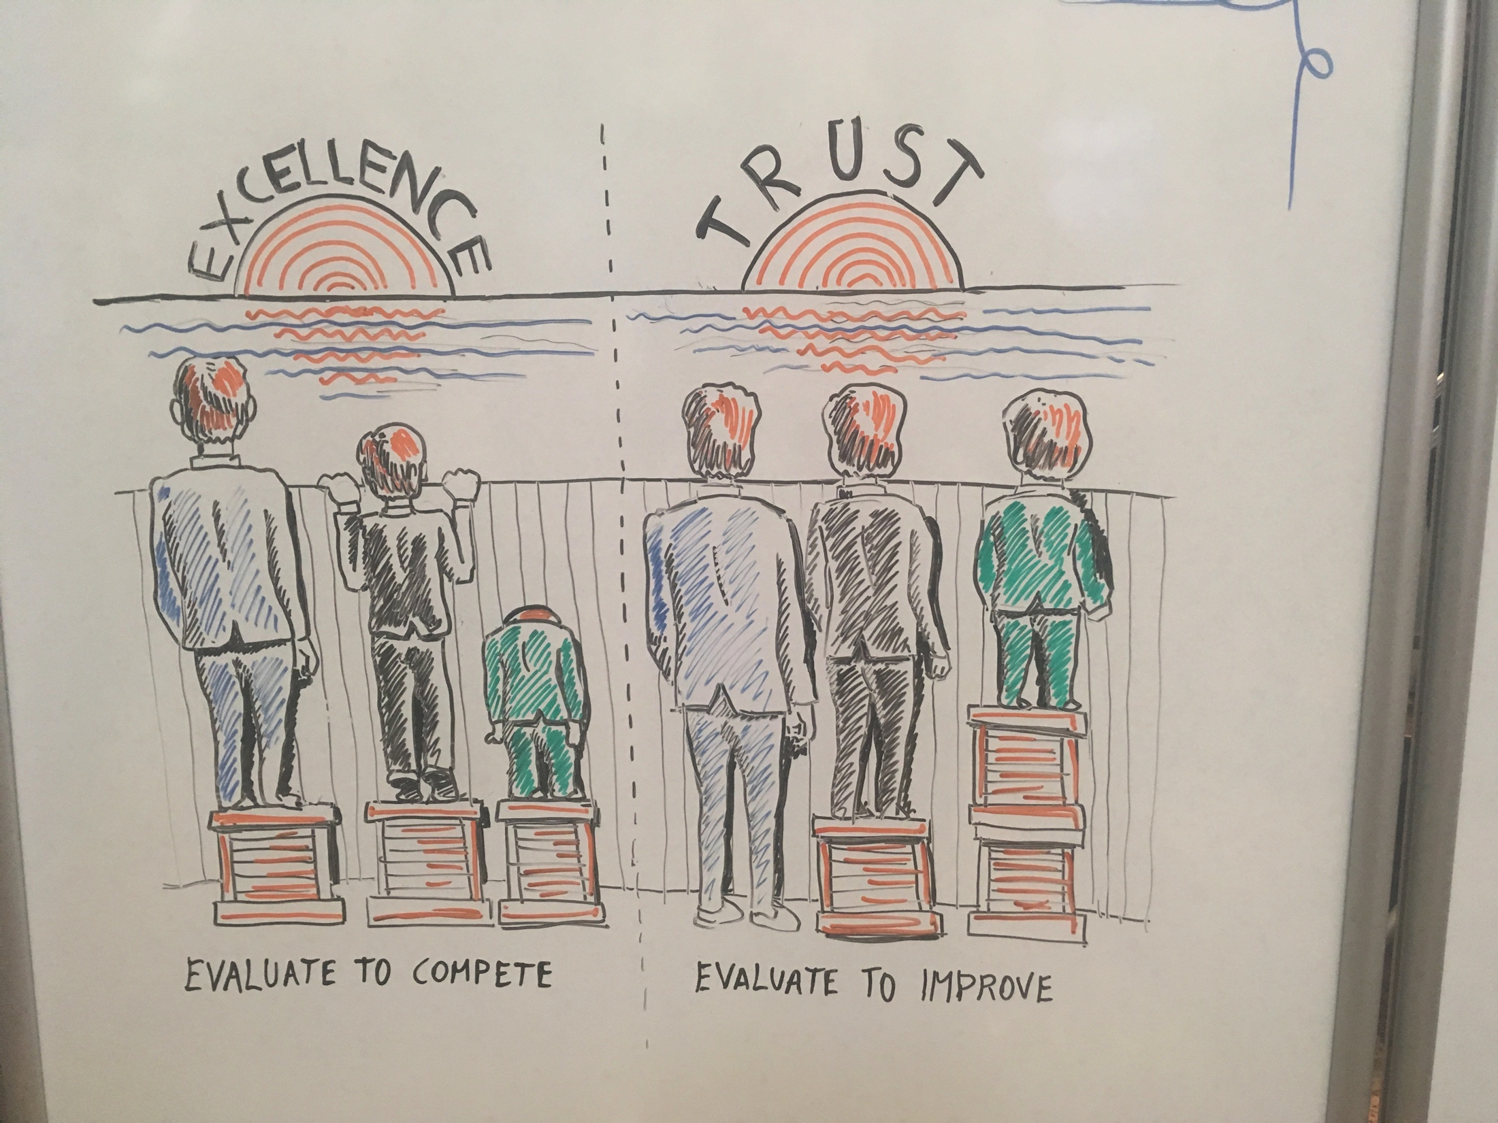

Slide 22
Any Questions?

